Slide 1
Snails, Paper, and Programming
A Computational Approach to Mollusc Morphology in Origami
Notes:
HMC is known for its Interdisciplinary approach with
a concentration in humanities.
I wanted to see how many different disciplines
I could fit into a short talk.
Slides are available, as are origami patterns.
You provide your own paper.
And, if working with live snails, your own snails.

Slide 2

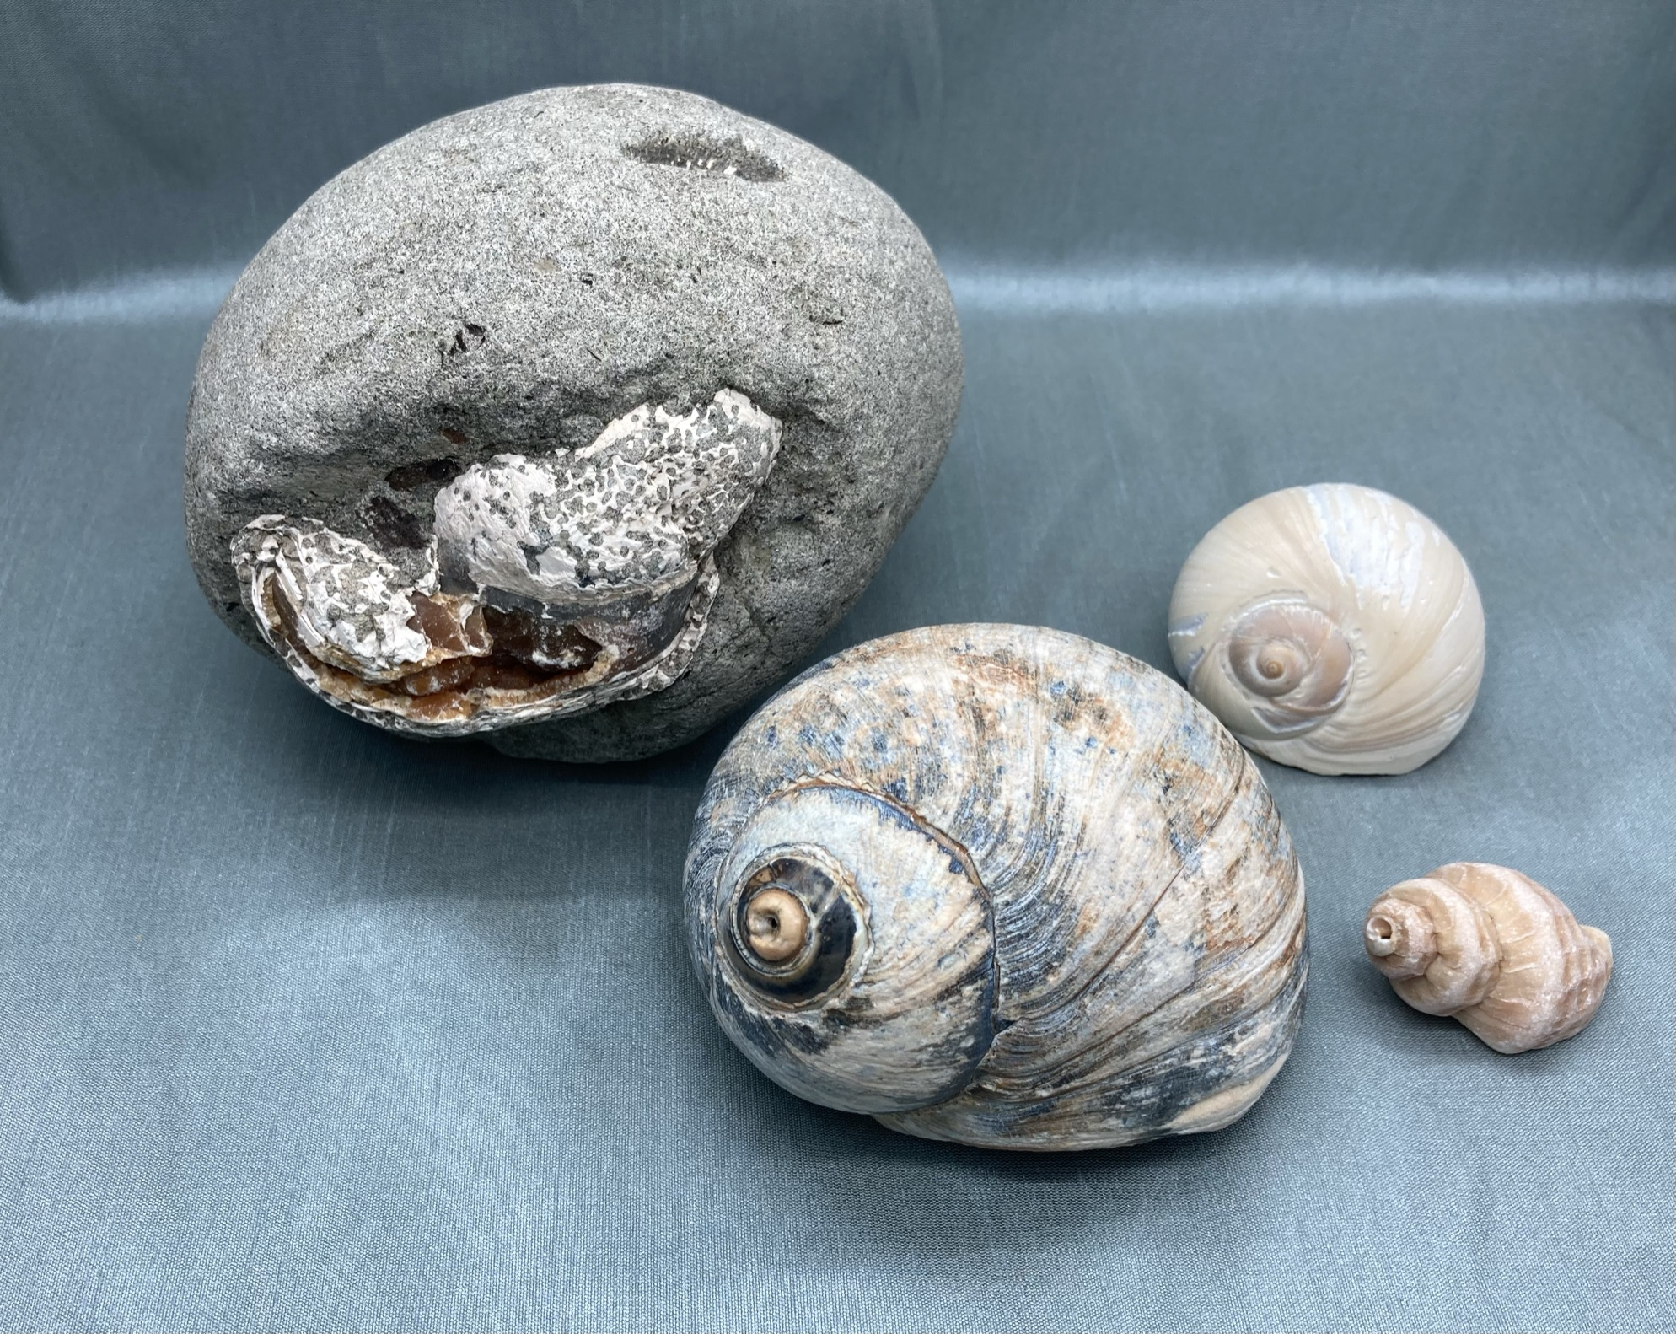
Snails
Ok, all molluscs with shells.
But not cephalopods.
Notes:
(Show shells live)
Let’s start with snails. Well snail shells.
And start with some terms
Planispiral (curves in on itself like a nautilus)
means it is in plane
Turbinate (curves off to the side like a snail, conical)
means it has a turban
Revolutions
Whorls are the physical representation of those revolutions
Protoconch (tip, apex, first shell of the baby snail)
Body whorl (last, largest opening)
Septa (interior lines between whorls)…
these are wholly internal though they can appear in the origami
Enough vocab, why are shells interesting?

Slide 3
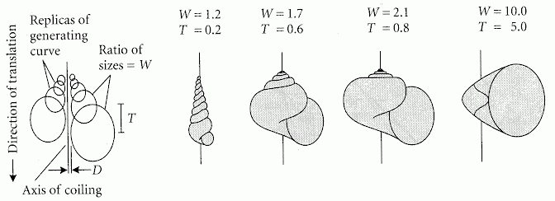
Computer as Aid in Describing Form in Gastropod Shells Raup, 1962
W: size ratio of successive generating curves
D: distance of the generating curve from the axis,
T: proportion of the height of one generating curve that is covered by each subsequent turn.
Notes:
Biologists need a way to describe shells
Mainly so they don’t name one after their kid
Only to find it was already described by someone else.
David Raup did this.
There were ways before this but nothing so elegant.
The first idea here is the generating curve, those circles represent the shape the whorl opens to.
I’m not going to read what the parameters means,
the two that you need to know are W which is about how fast the whorls get bigger,
and T which is how much whorls get covered as the shell grows.
So going back to our terms, planispiral,
like a nautilus that curves in on itself,
has a large T
Where turbinate or conical shells have a lower T,
allowing them to have pointy ends.
And check out that paper name… computers in 1962.
Imagine how many punchcards this paleontologist dealt with.

Slide 4
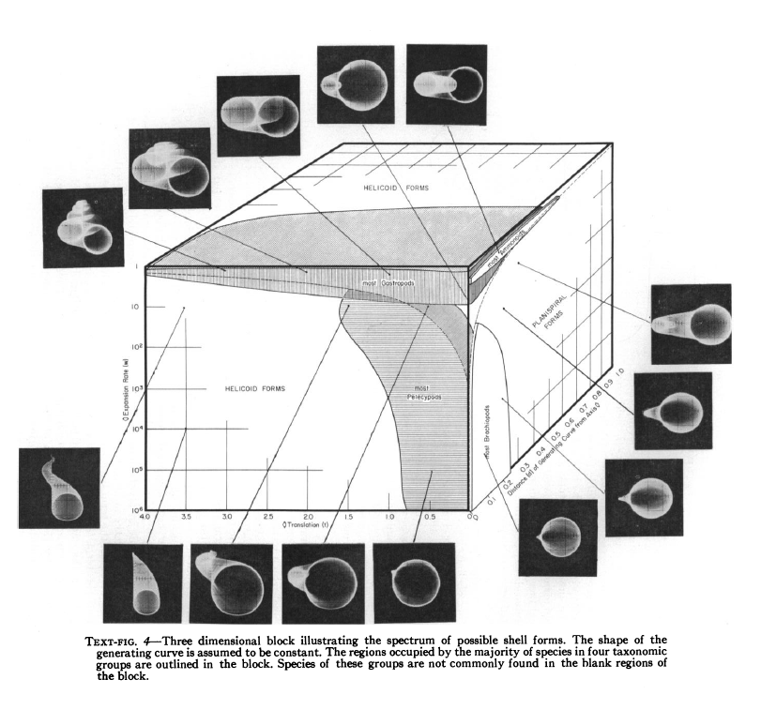
Geometric Analysis of Shell Coiling
Raup, 1966
Notes:
Raup went even further,
graphing fossil shells
and how they worked with his description method
It shows that nature has tried
a lot of the options
in the parameter space.
I could go on about how nifty this is but…

Slide 5
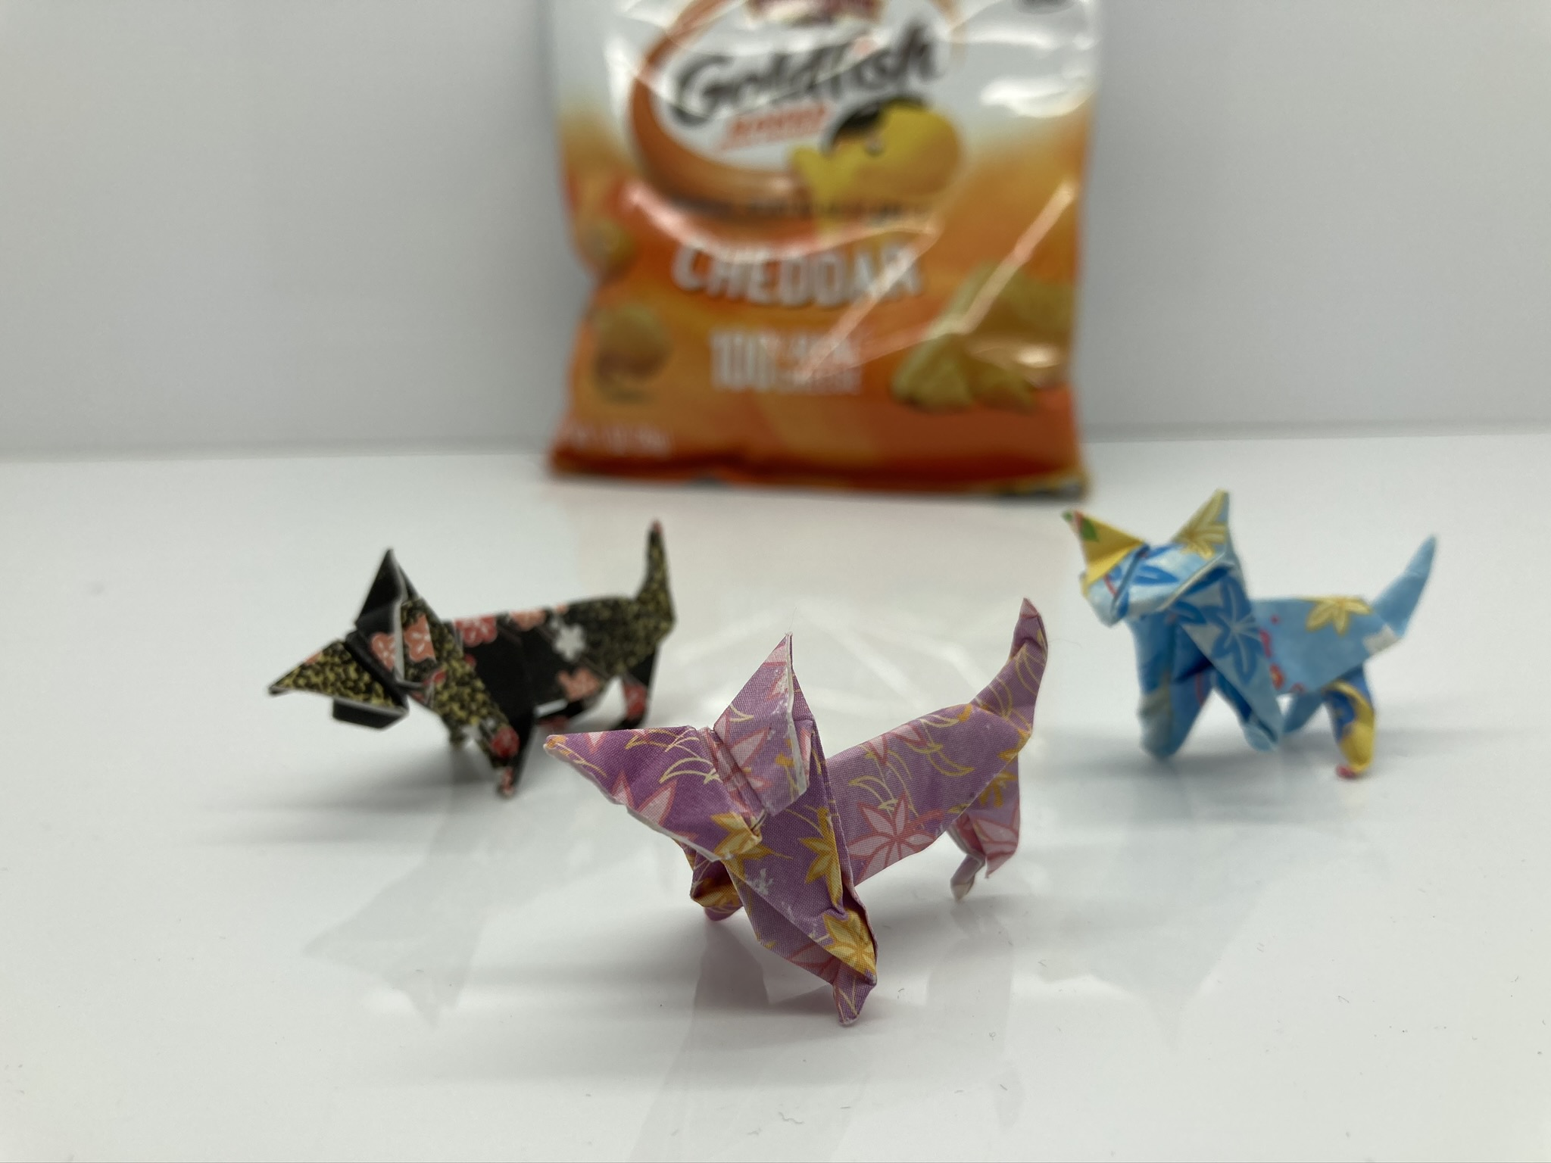
Paper
It started with cats.
As usual.
Notes:
Moving on to paper.
I liked origami but it wasn’t an obsession
Until about two years ago
when I needed to fold a really good origami cat
so I could put in
an electronic purring mechanism.
I folded hundreds of cats
I started to understand that
origami isn’t about successfully folding a 57-step dragon
but folding the dragon over and over
until you understand it.
A lot like calculus.

Slide 6
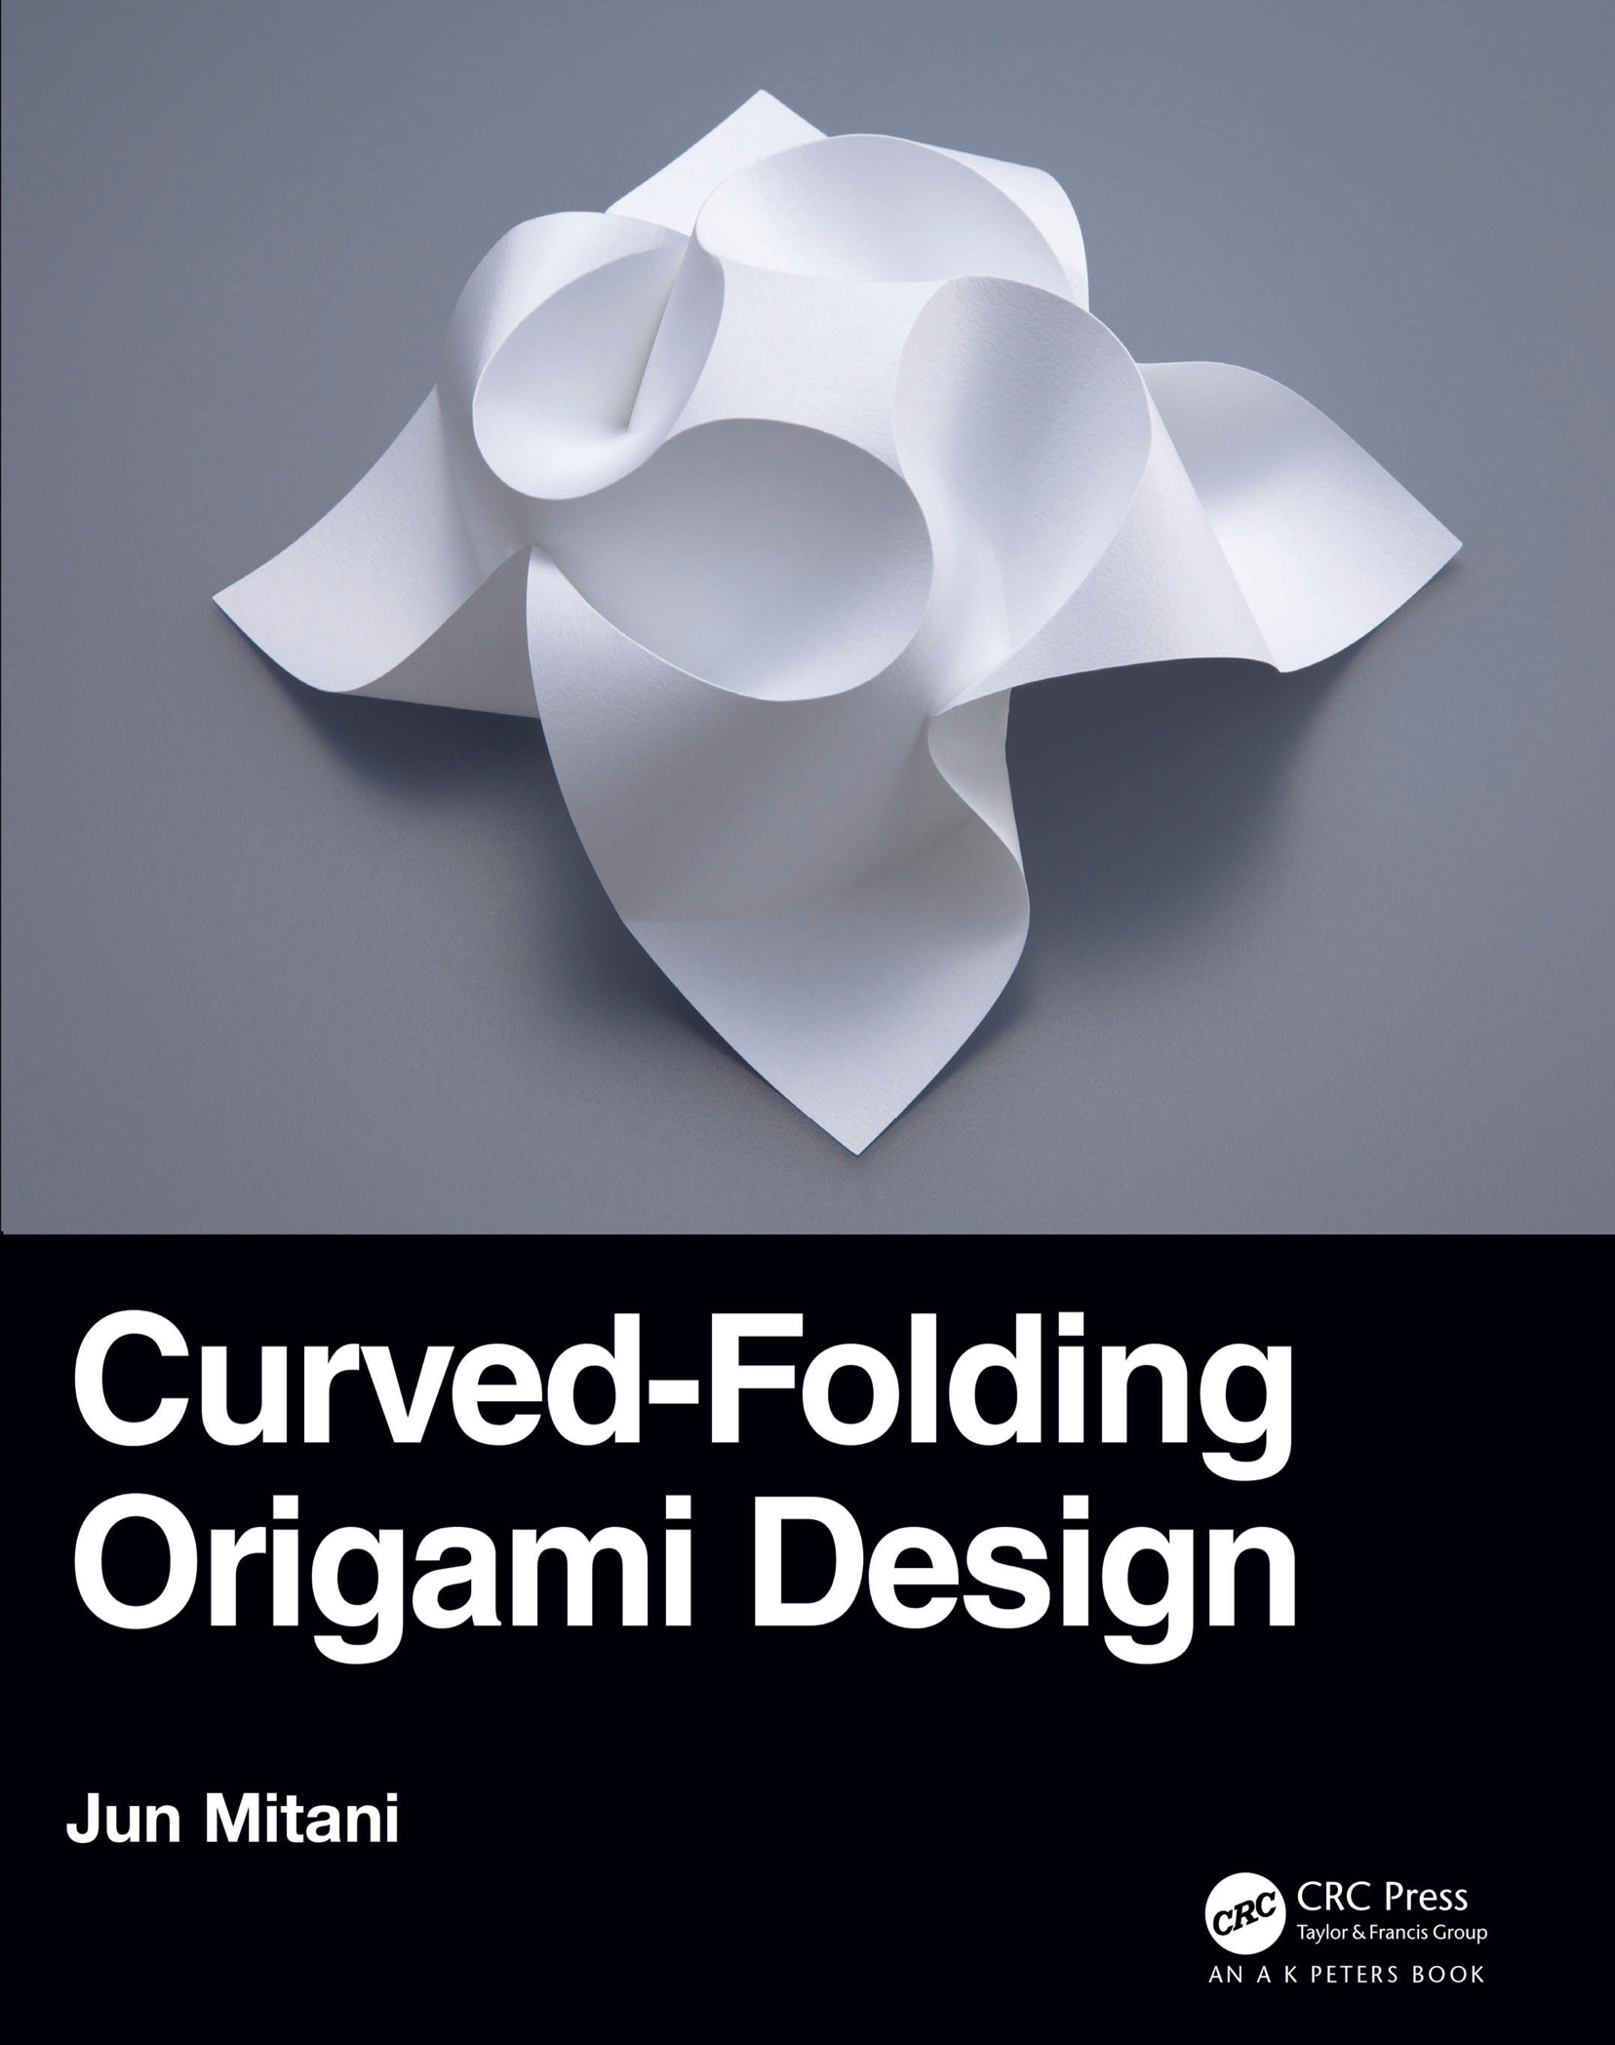
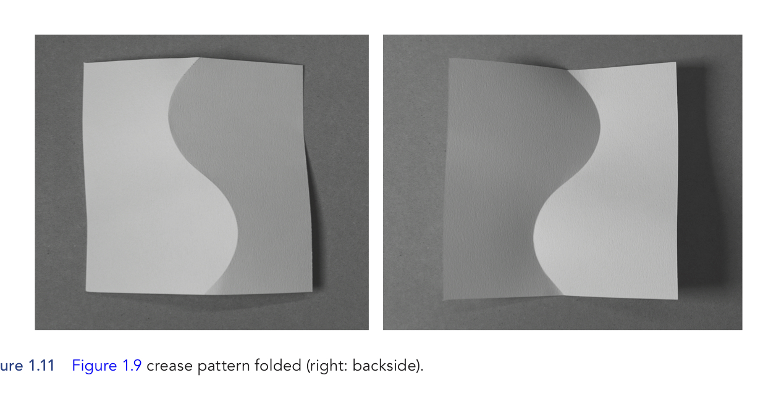
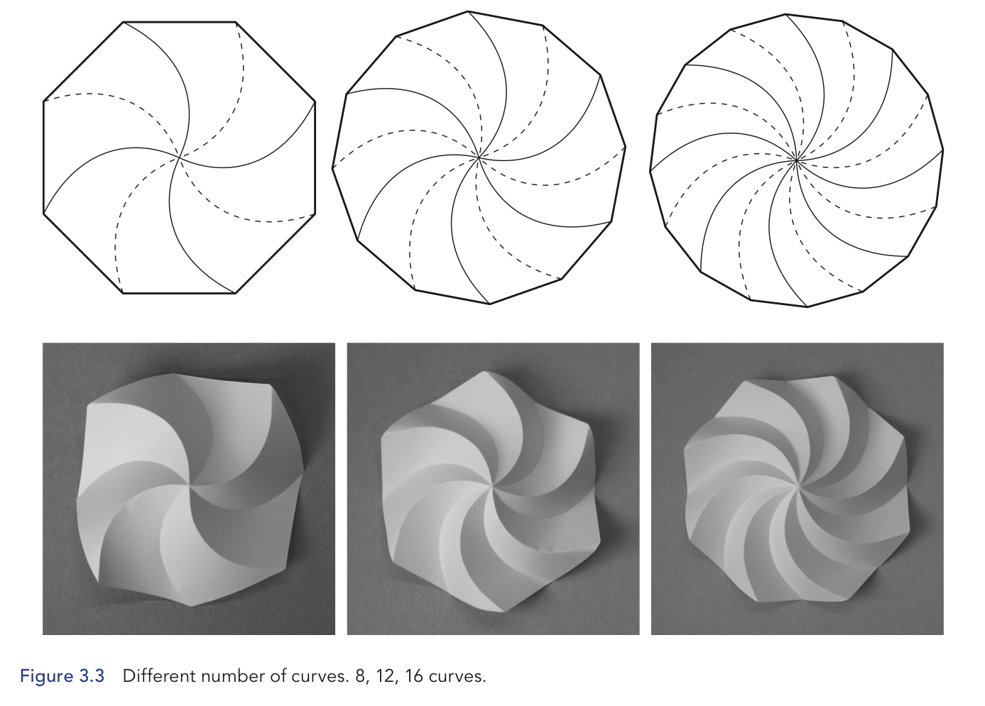
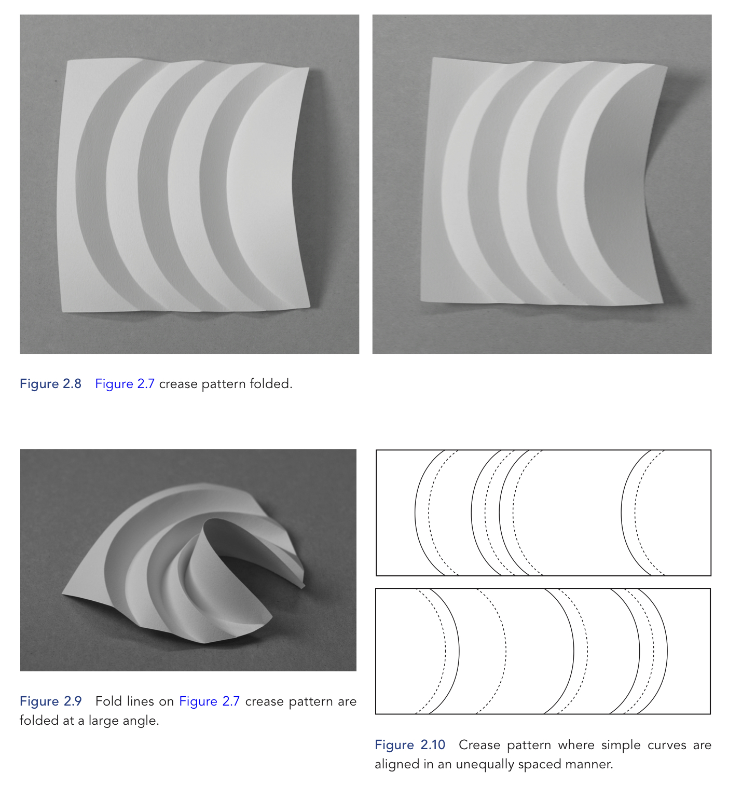
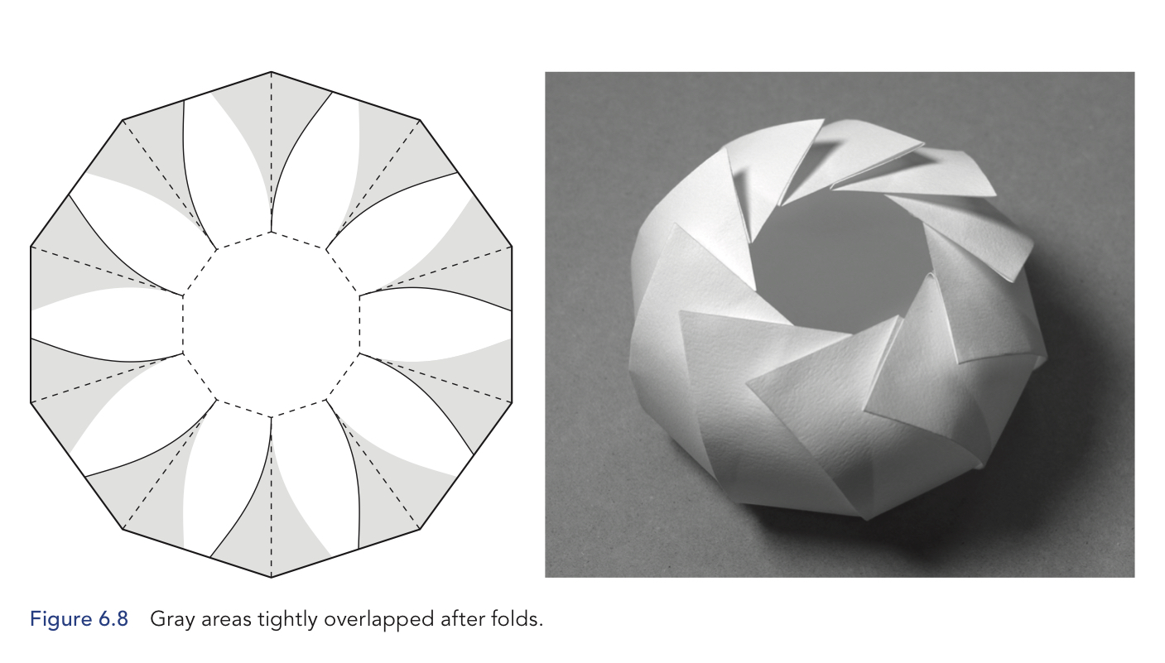
Origami Curves
Notes:
Somewhere in there, I found curved crease origami.
The results are so otherworldly and beautiful.
David Huffman (of Huffman codes!) was big into curved origami.
Curves break the origami rules, the result can’t be flat, it has to be 3d.
The curves have to be precise so
The patterns tend to be generated via computer.
Also, you have to
Prescore the paper
or you can’t have a curved fold.
I did prescoring by
printing out patterns
and then using a ballpoint pen to score the paper.
Eventually I got a Cricut, a machine that does it for me.
Finally, for curved crease origami, cardstock is the way to go here,
thicker paper is much easier to prescore and to fold.

Slide 7
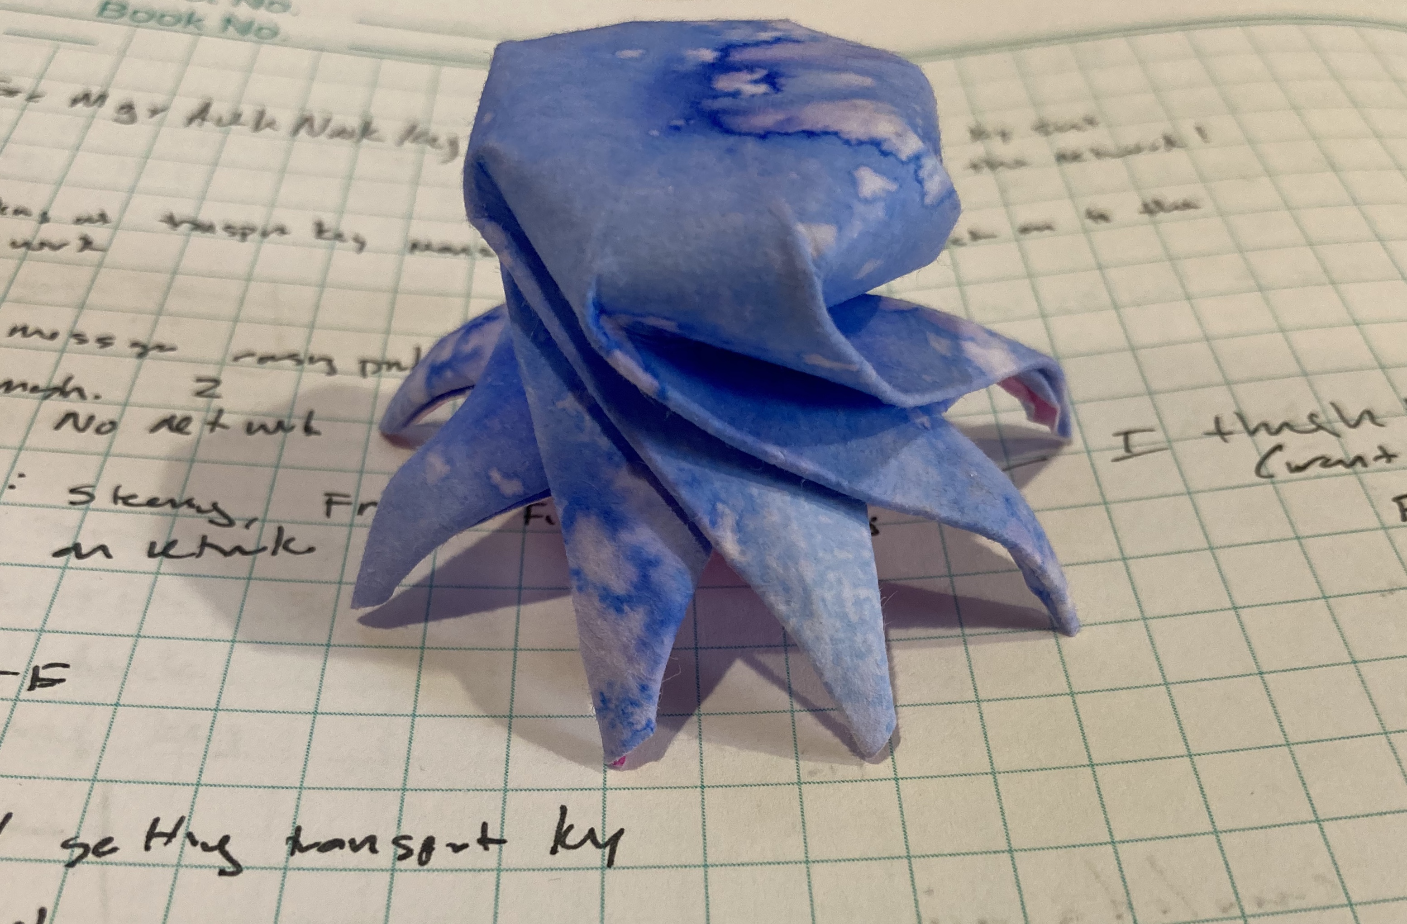
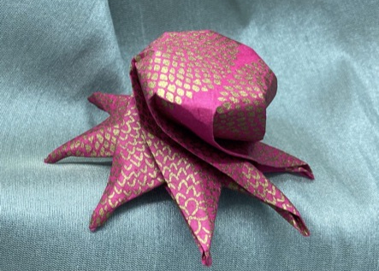
My Curved Crease Octopus
I know, I said no cephalopods.
Notes:
By this point,
I was looking beyond folding what other people did
And thinking about designing my own patterns.
This octopus pattern isn’t too difficult to fold…
I don’t think. I mean other people have successfully done it
so I think it is ok.
I got a book about folding sea creatures so
I could make an origami aquarium.
One of the creatures was a nautilus and
I couldn’t fold it.
Step 22 just killed me.
When I noticed a failed curved crease bowl
looked like a shell
after I accidentally cut it in half.
I tried to make a shell pattern
and it worked… sort of.
No one else could fold it
because it was 85% made of my determination of
“this is going to look like a shell, dang it”
Happily, my husband Chris gave me a book as a present.

Slide 8
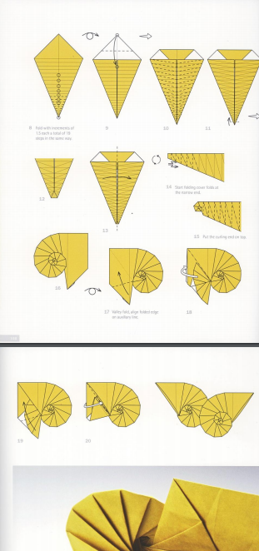
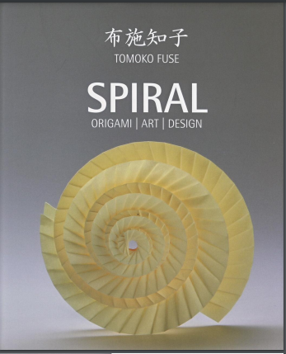
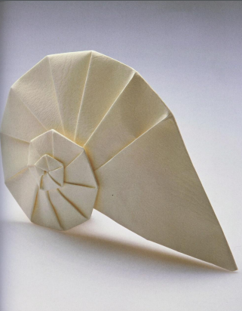
Origami
Tomoko Fuse’s Spirals: Navel Shell
Notes:
Tomoko Fuse is a super famous origami artist.
Take my word on that.
She does a lot of things with spirals,
has a whole book about them.
And another book about spirals and boxes
which is nifty
but not on topic.
Anyway, she had this navel shell which is nice looking.
Note these are pics from her book, mine are not this elegant.
Also, 300 pages later, I understand how to make that nautilus but
I no longer care about the sea creatures because, well, seashells.

Slide 9
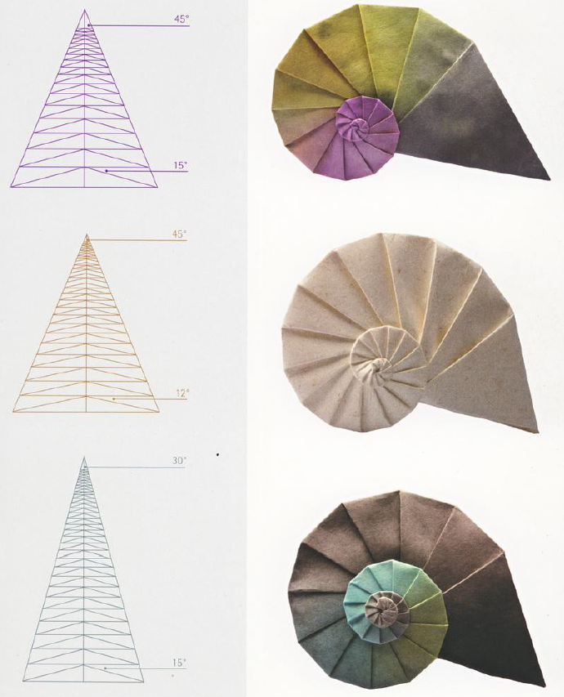
Triangles
Central and Spirality Angles
Notes:
I think this was the page that did me in.
Angles, triangle, modifying geometry to get
different physical structures.
A larger central angle (top angle) leads to
a large body whorl and smaller protoconch.
A larger spirality angle (the smaller angle) causes
the spiral to grow more quickly,
leading to a bigger
but blockier, less rounded form.
I didn’t choose angle names, they are from Fuse’s book.
But remember back to Raup and his
W which described how fast the shell grew?
And T which is related to how much of the old whorl
is covered by the new

Slide 10
Programming
https://github.com/eleciawhite/origami
Notes:
I wanted to reproduce the images Fuse’s Spiral’s book.
I’m accustomed to prescoring
which makes folding straight lines easier
especially if they have to be precise
For prescoring I needed to make vector files.
I knew I’d use Python and matplotlib
because I use that quite a lot for data wrangling for my gadgets
Still, how do you make a triangle with a bunch of
horizontal lines and some more triangles inside?

Slide 11
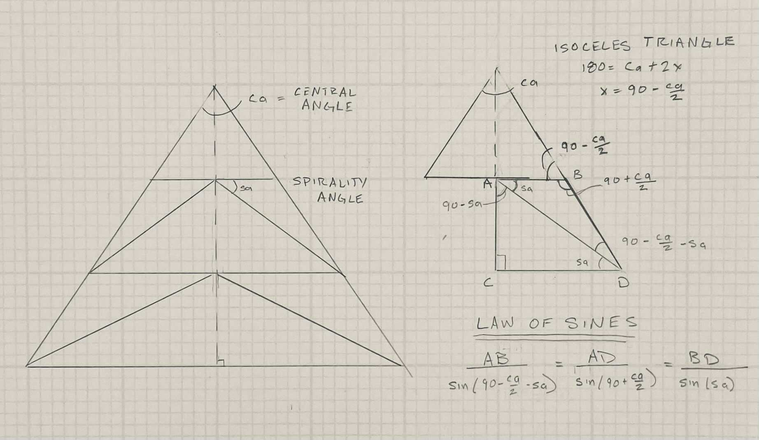
Develop the Navel Algorithm
Is this really an algorithm?
I’m just creating a triangle
Then adding a line with some other triangles
Then repeatedly adding another line until the end.
And finally containing it all in an outer triangle.
Notes:
I had two of three angles
which meant I could get all three.
I had to choose a length
and everything else fell out from the law of sines
Once I had one horizontal line with its two triangles,
I could go down to the next one and the next and so on.
(I chose the initial horizontal length to be one.
Because, really, isn’t that secretly everyone’s favorite number?)

Slide 12
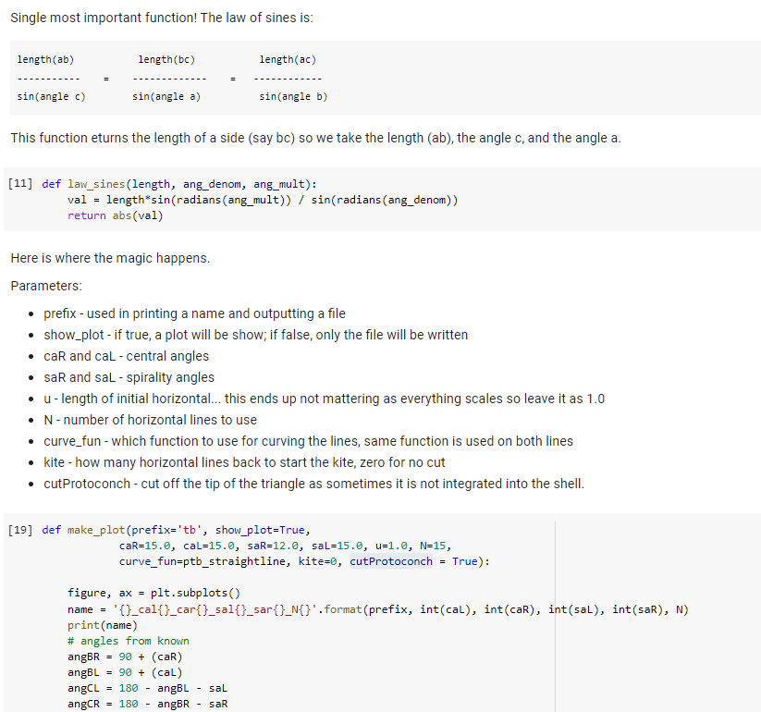
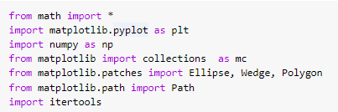
Python
https://github.com/eleciawhite/origami
There is also an online colab (like Jupyter) so you don’t need to install anything.
Notes:
I’m not going to go over the code with you.
But I will say that there is a colab
which is a way to intersperse code and text.
It is like Jupyter notebooks
but online so you don’t have to install anything.
Run it in your web browser.

Slide 13
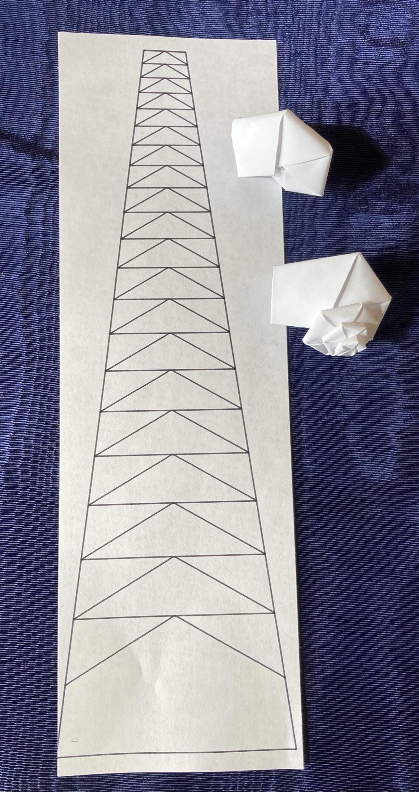
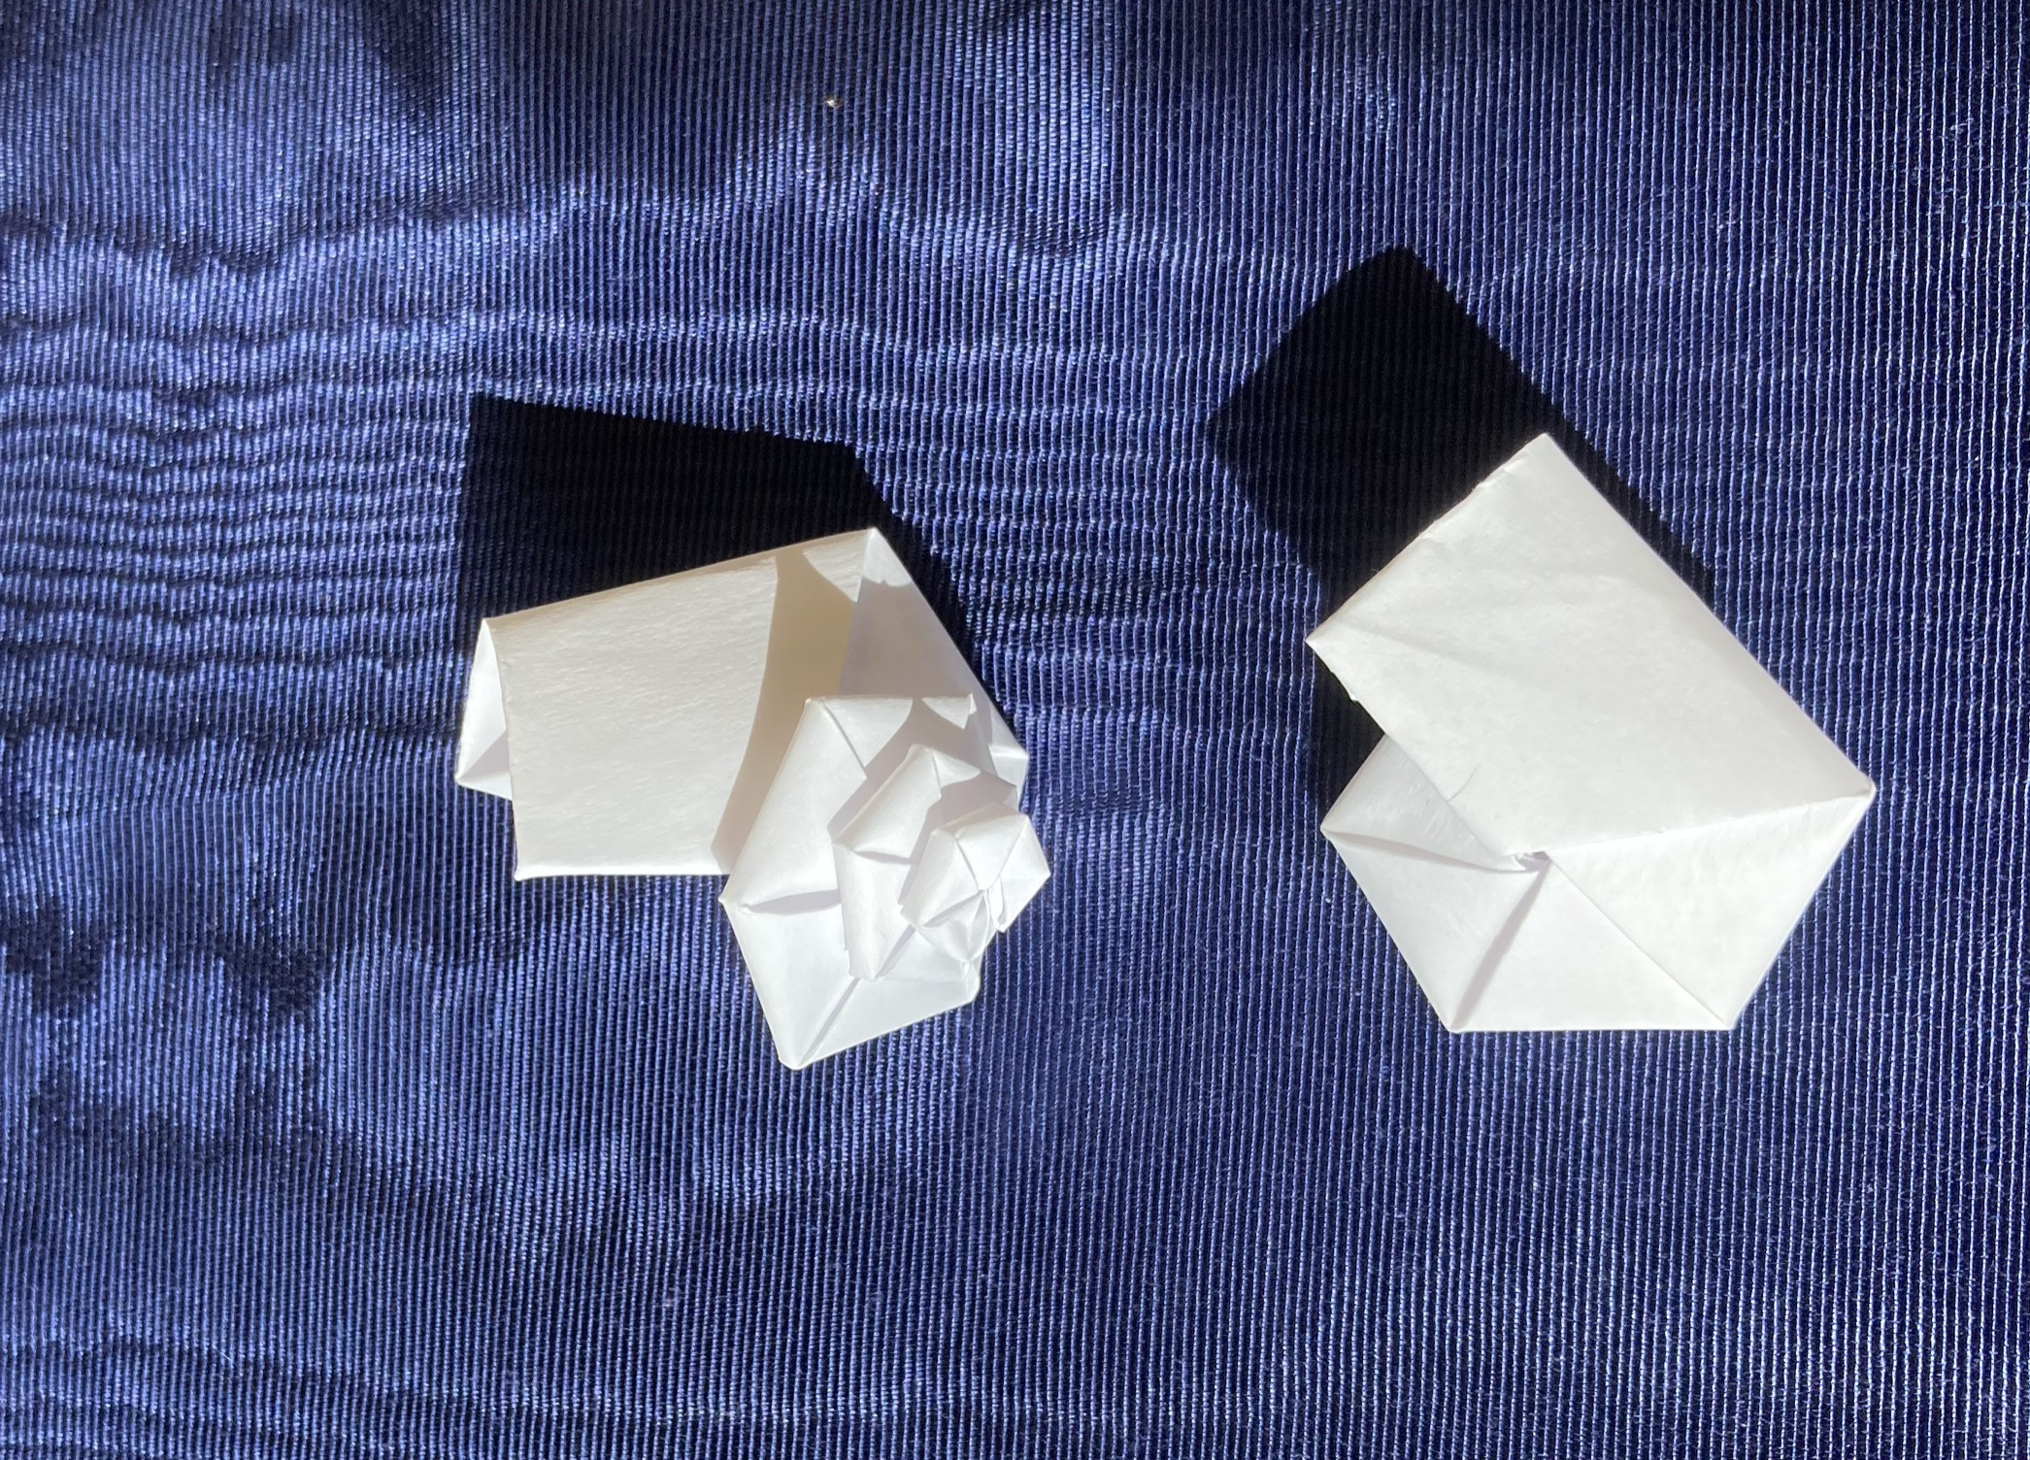
Fuse-Style Navel Shells
ca = 15
sa= 30
Notes:
(live show snails)
Mission accomplished: we have patterns that are easy to generate.
So here we have a pattern, a snail folded in on itself
and a snail that is pulled out like Fuse’s navel shells are.
There is a step in the folding where you pull out the protoconch
and then make every step after that a bit more difficult as you
work around paper that wants to fold in on itself.
However, It seems like the snails shouldn’t be flat,
they should be conical.
Flat snails seems like a bad idea
or a sad blues song.

Slide 14
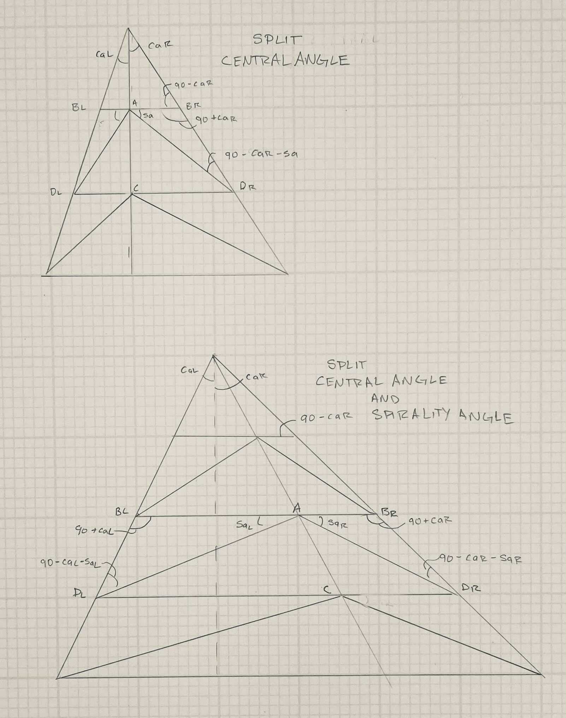
More Geometry
This is no way to lead your life.
Though maybe it is.
I mean, I feel pretty good about myself after doing math. Like I’m smart and know stuff.
Ada Lovelace used to do calculus problems for fun. When I heard that I thought that sounded interesting, wished I could do.
Then I realized… no one is stopping me. Except me.
Notes:
It seems like there might be a better way.
What if the central angle wasn’t balanced?
What if the spirality angles weren’t balanced?
Why do I spend so much of my free time doing geometry?

Slide 15
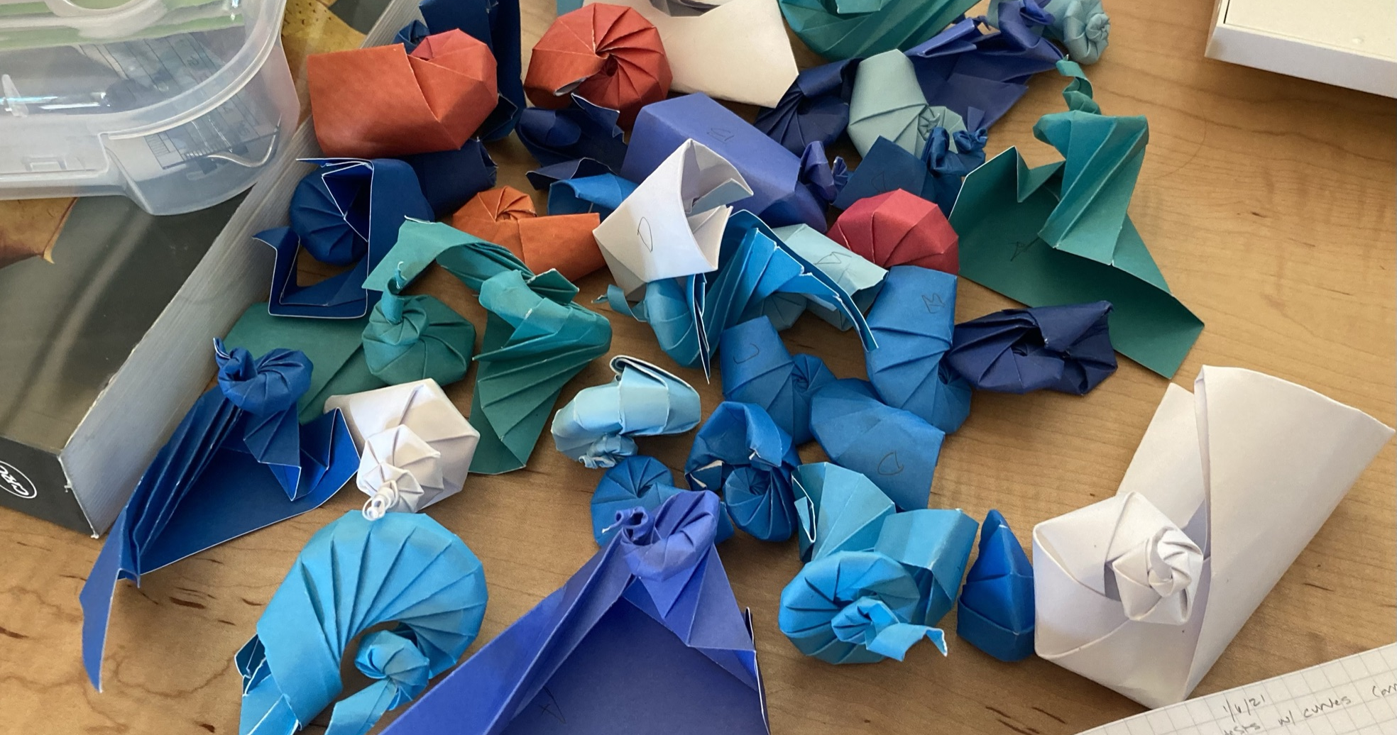
Notes:
It turns out
Evolution is cruel
and there are many parameters
that do not work.
Many, many.
This, by the way is why I needed to learn about Raup’s shell description method.

Slide 16
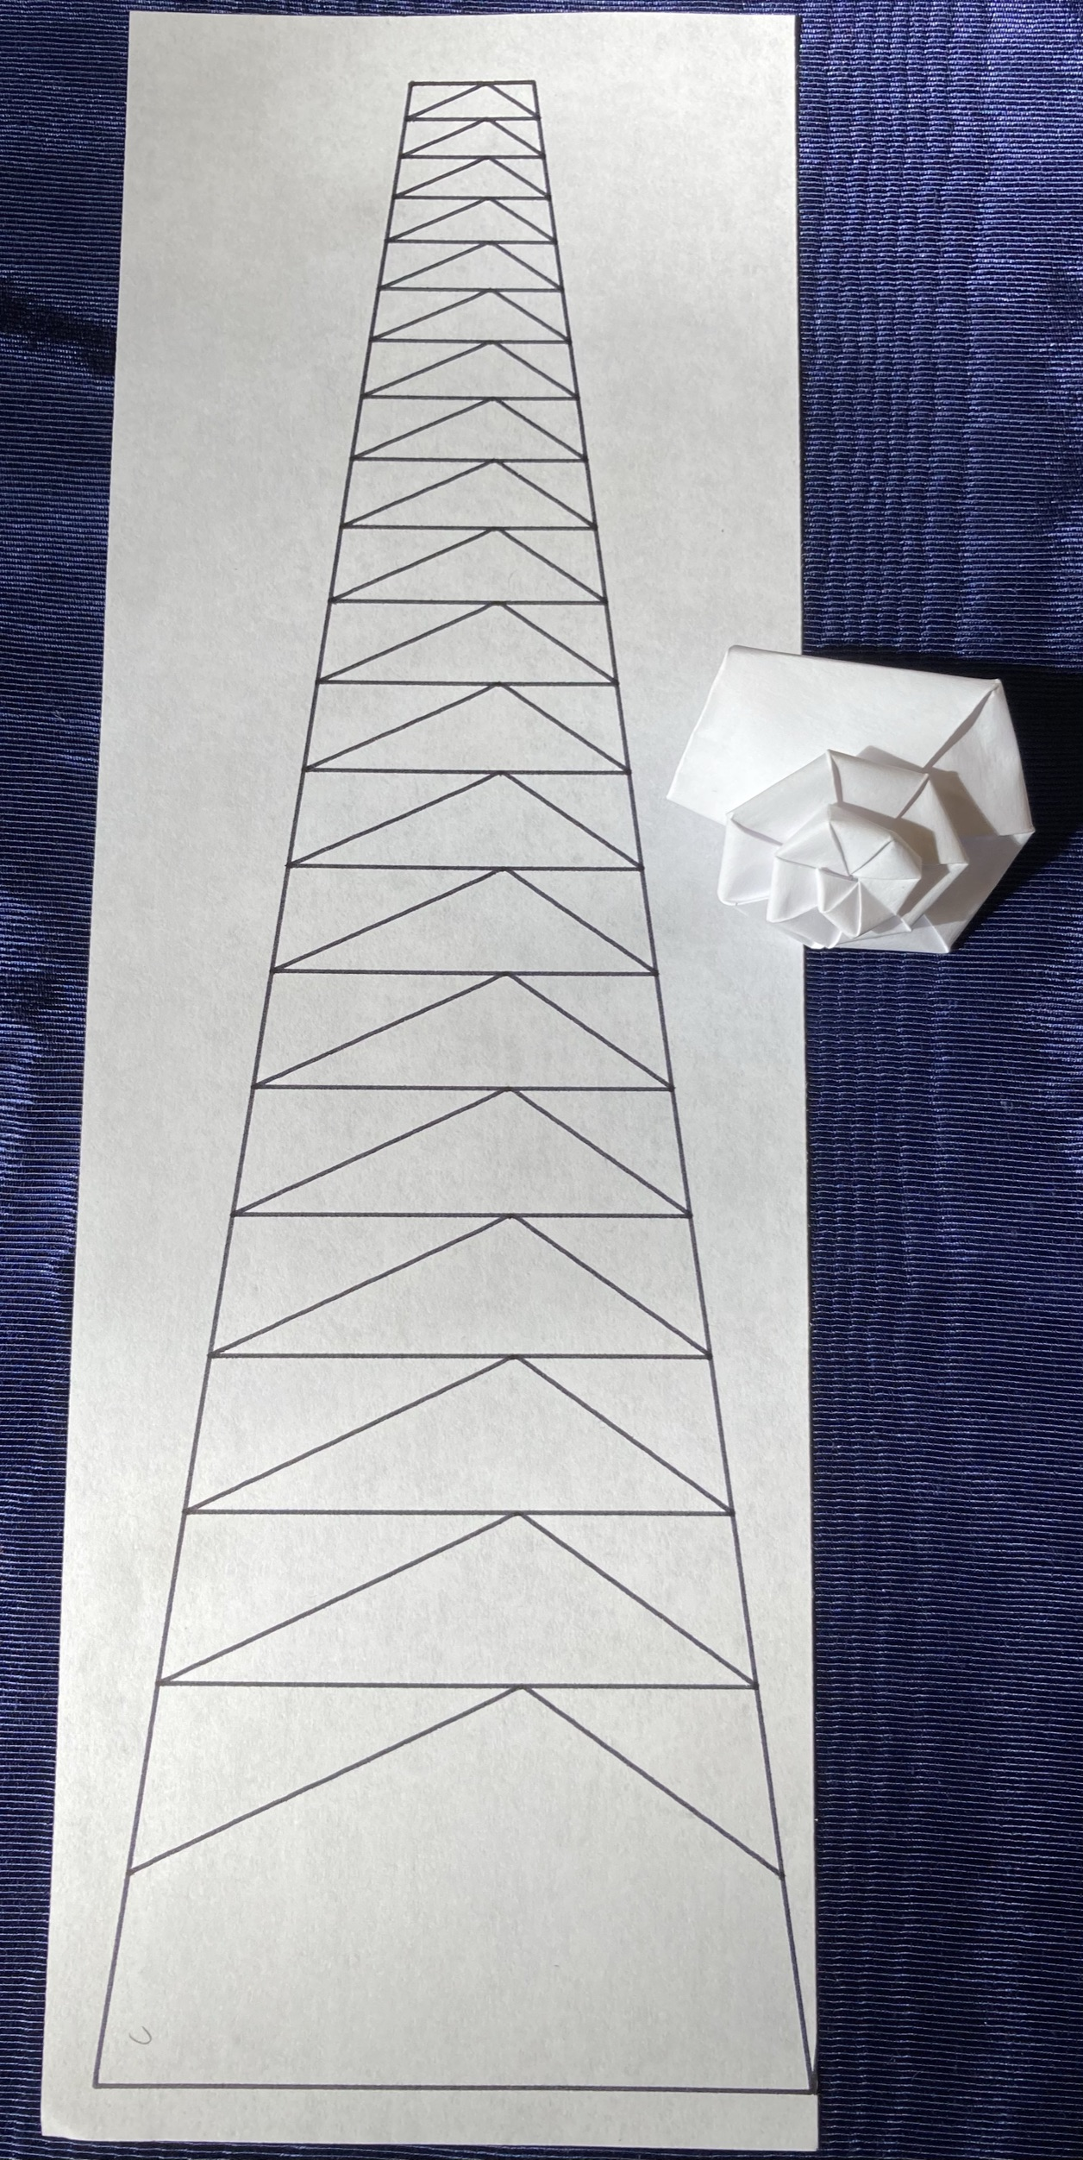
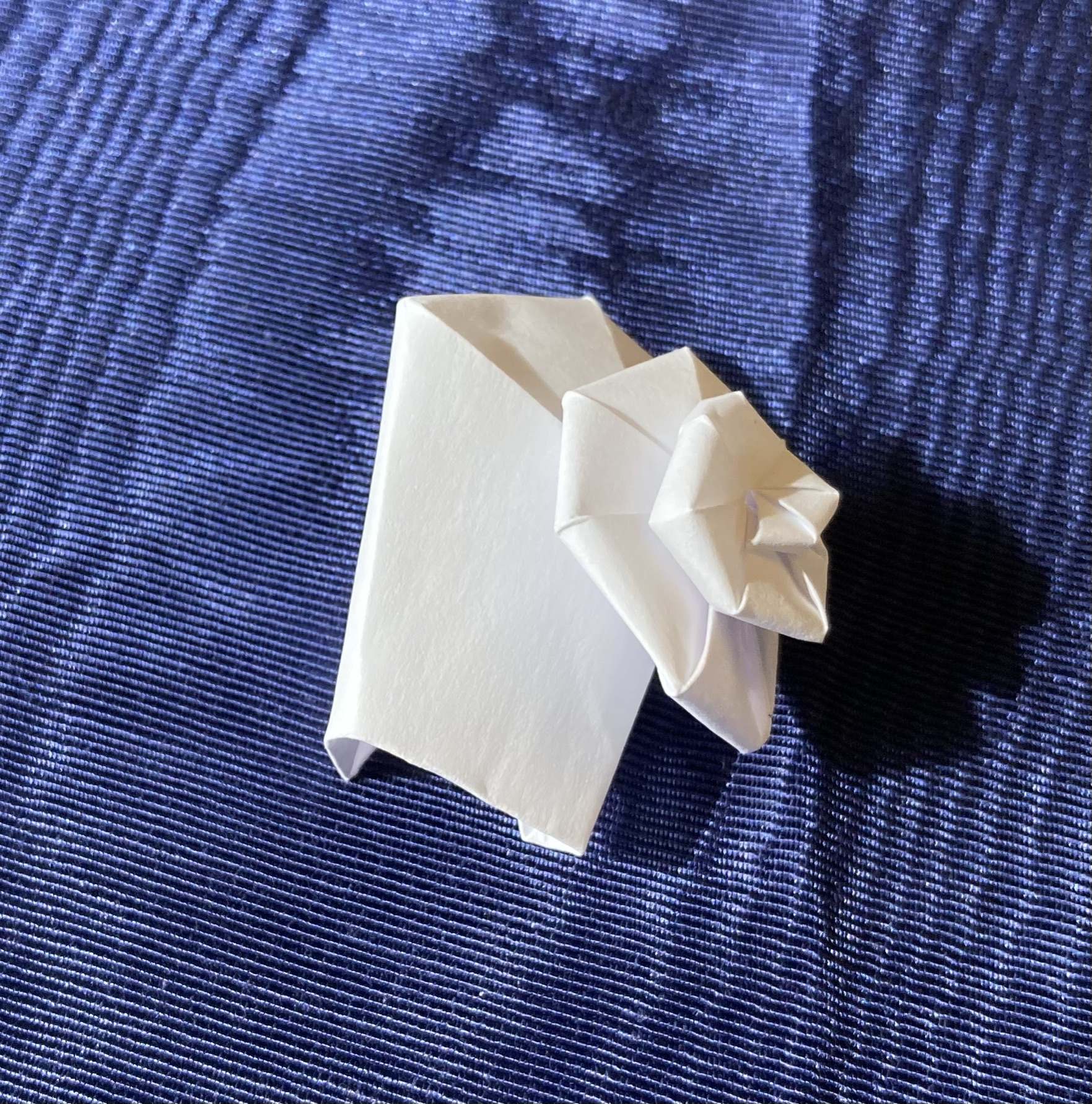
Unbalanced Spirality Angle
caL = caR = 7.5
(ca = caL + caR = 15) saL= 35, saR = 25
Chirality
Notes:
(Live show snails)
But some parameters do work.
Here the spirality angle is unbalanced,
it doesn’t look a lot different from the unmodified one
but it is easier to fold.
One neat thing here,
where the parameters aren’t balanced
we get the idea of chirality,
are they curling left or right?
Snails are hermaphrodites,
their bits have to line up.
They don’t
unless the shells are going to the same direction.
Just a snail fact I thought you should know.

Slide 17
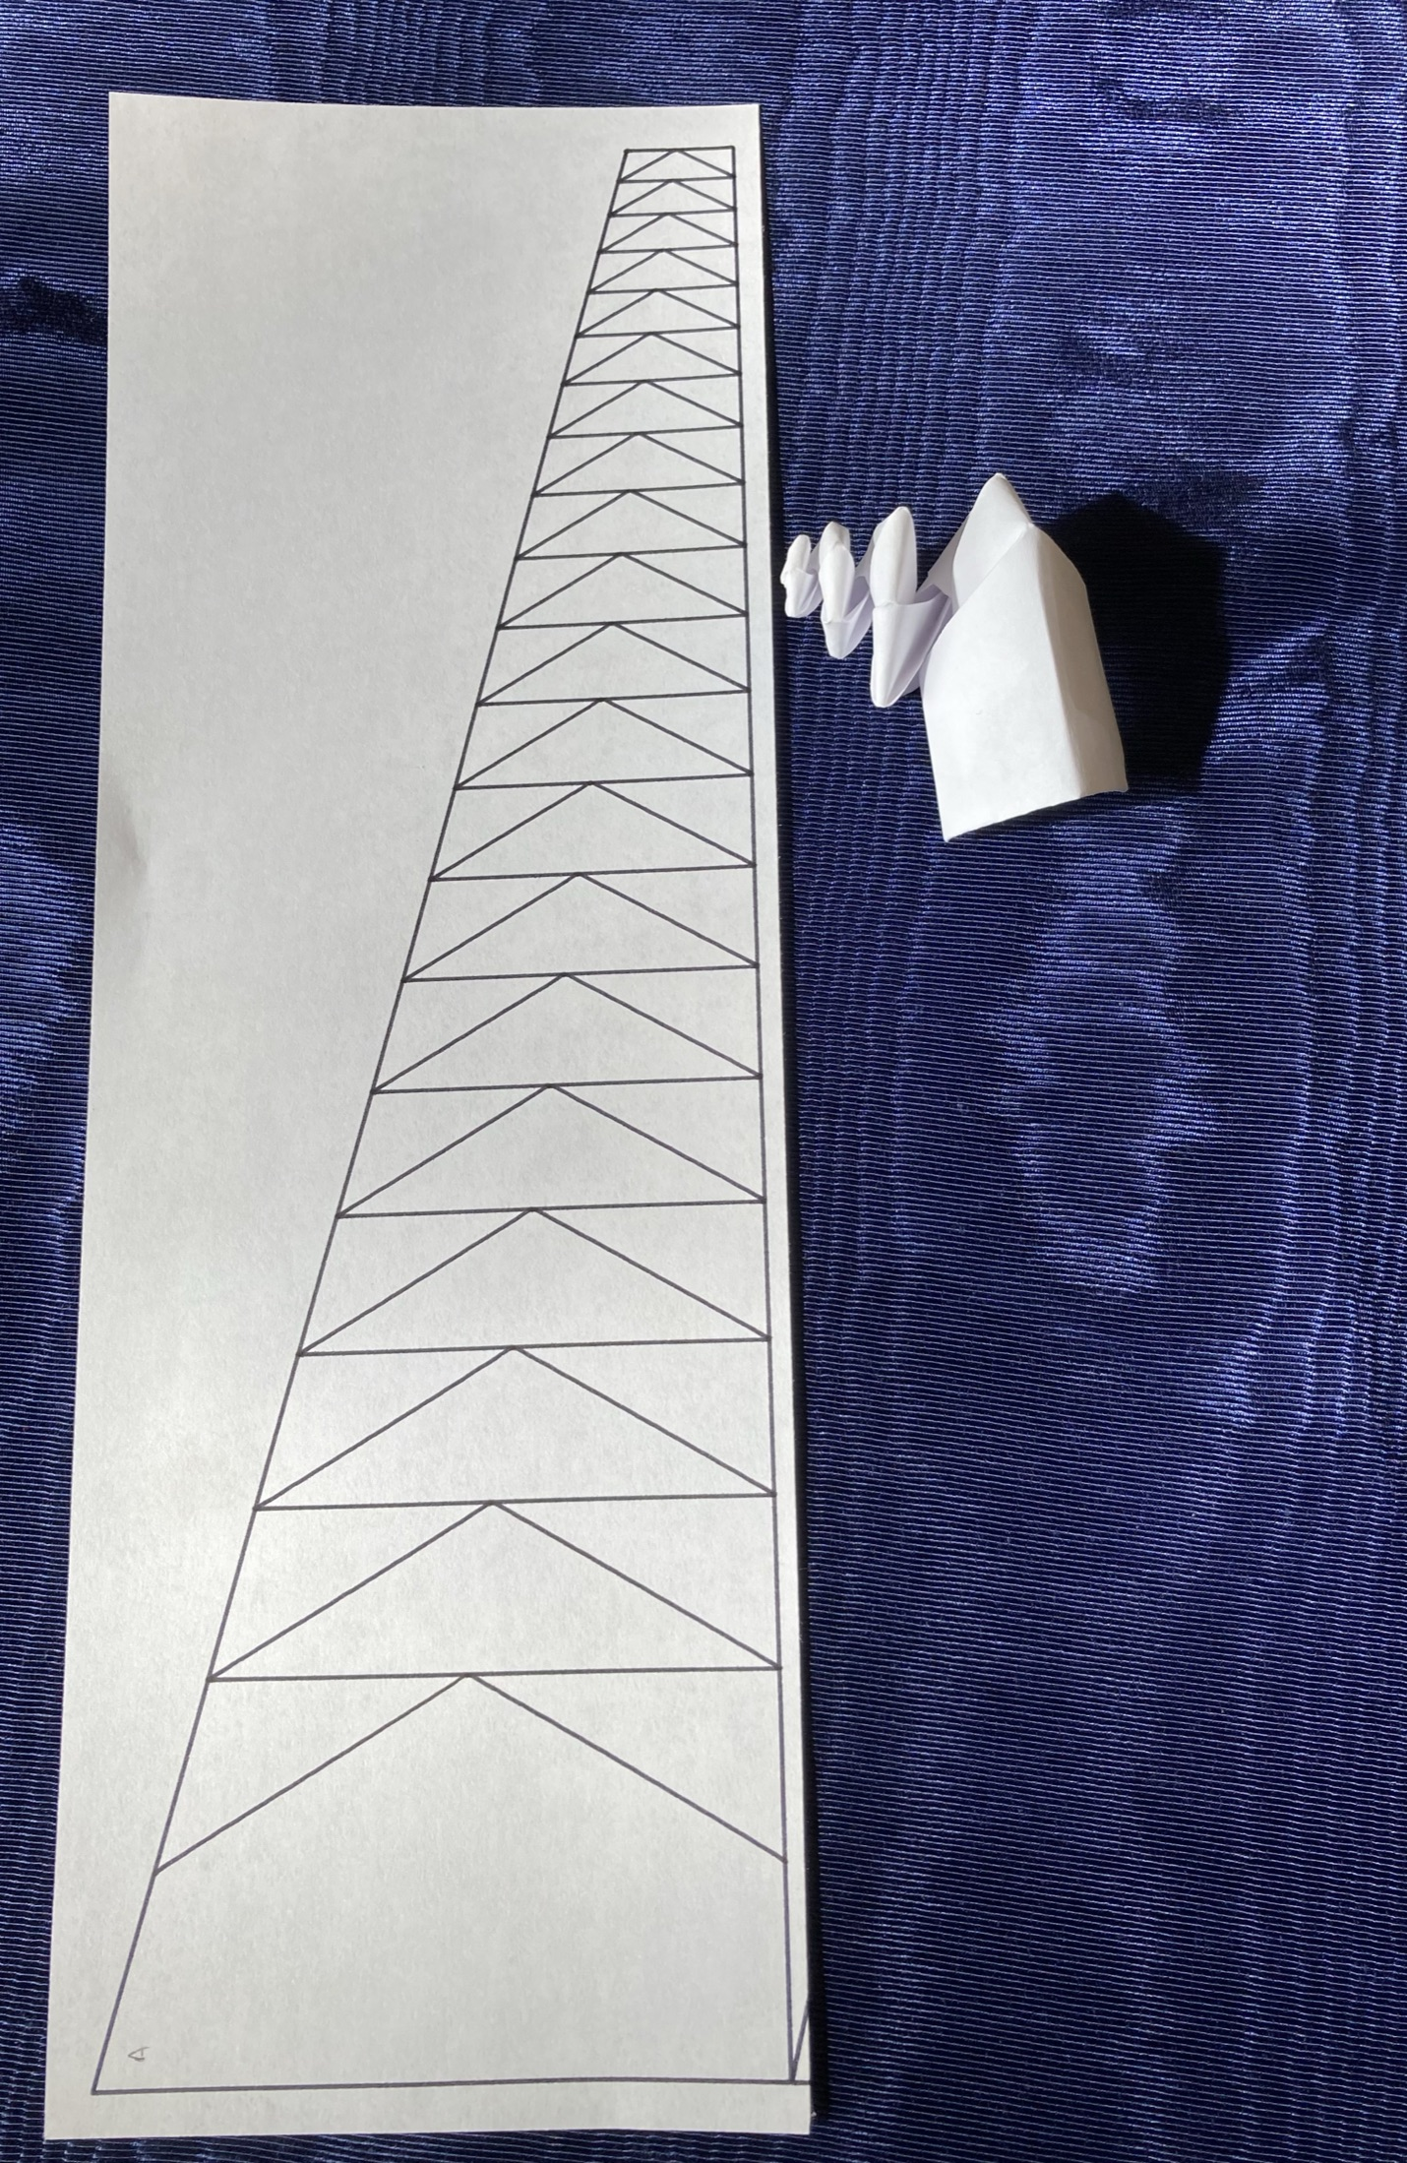
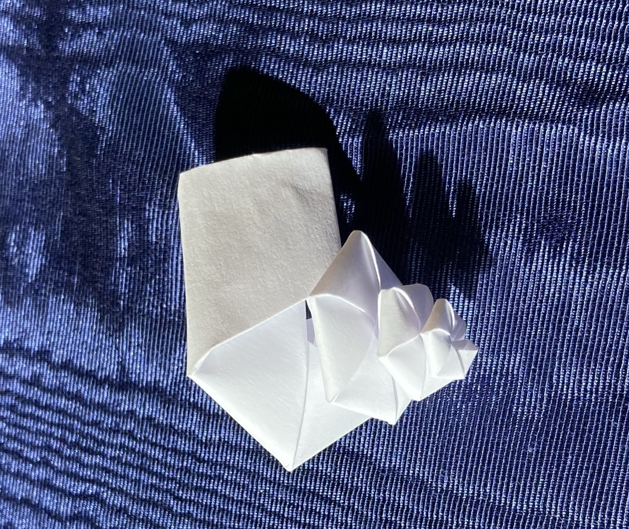
Unbalanced Central Angle
caL = 0, caR = 15
saL= saR = 30
Notes:
(Live show snails)
Very nice height, whorls don’t touch much
You might say it is quite up to T

Slide 18
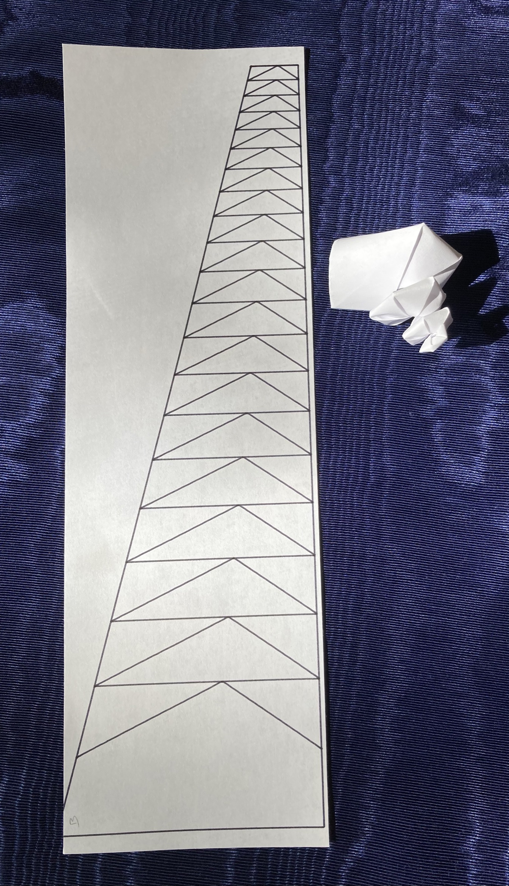
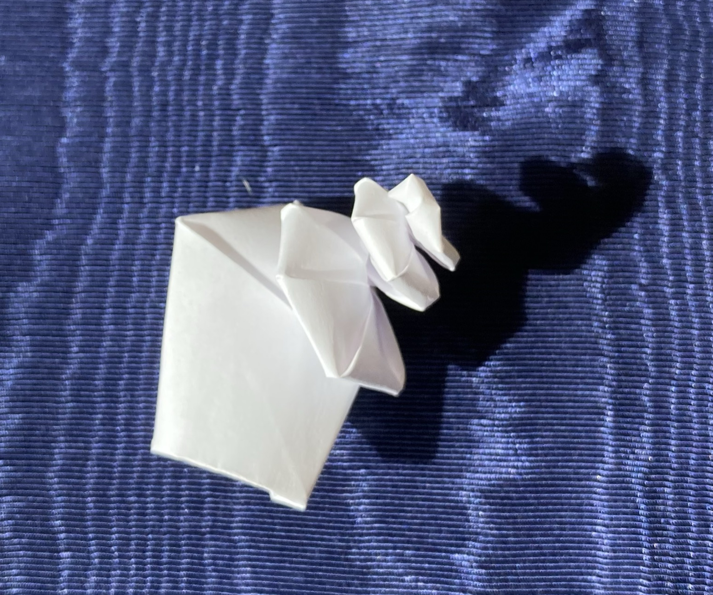
Unbalanced CA and SA
caL = 0, caR = 15
saL= 35, saR = 25
Notes:
(Live show snails)
Putting it all together we get a pretty good turbinate snail.
Nice height and the whorls touch
Chunky but we know if we decrease spirality,
the snail will grow more slowly and be smoother.
But wait… what if we add in curves?
What if we replace the straight lines with Bezier curves?

Slide 19
Copy Paper Snail
Notes:
(live show snails)
Earlier I mention curved crease and cardstock
so you can be suitably impressed
that all the white snails I’m showing
are made of copy paper.
Ehn, I know you aren’t suitably impressed
but let me tell you,
origami people would be wow’ing right now.
Though they are such snobs about paper,
maybe they’d be closing their Zoom windows instead…
Anyway, I used copy paper instead of something fancier
so you know you can make these,
either make your own by running the script
or get a working SVG from me.
I had kind of hoped to fold one together as we talked but…
but ten minutes.
Also, I realized I’d be the one talking,
I usually only fold in meetings
when other people are talking.
And my camera is off.

Slide 20
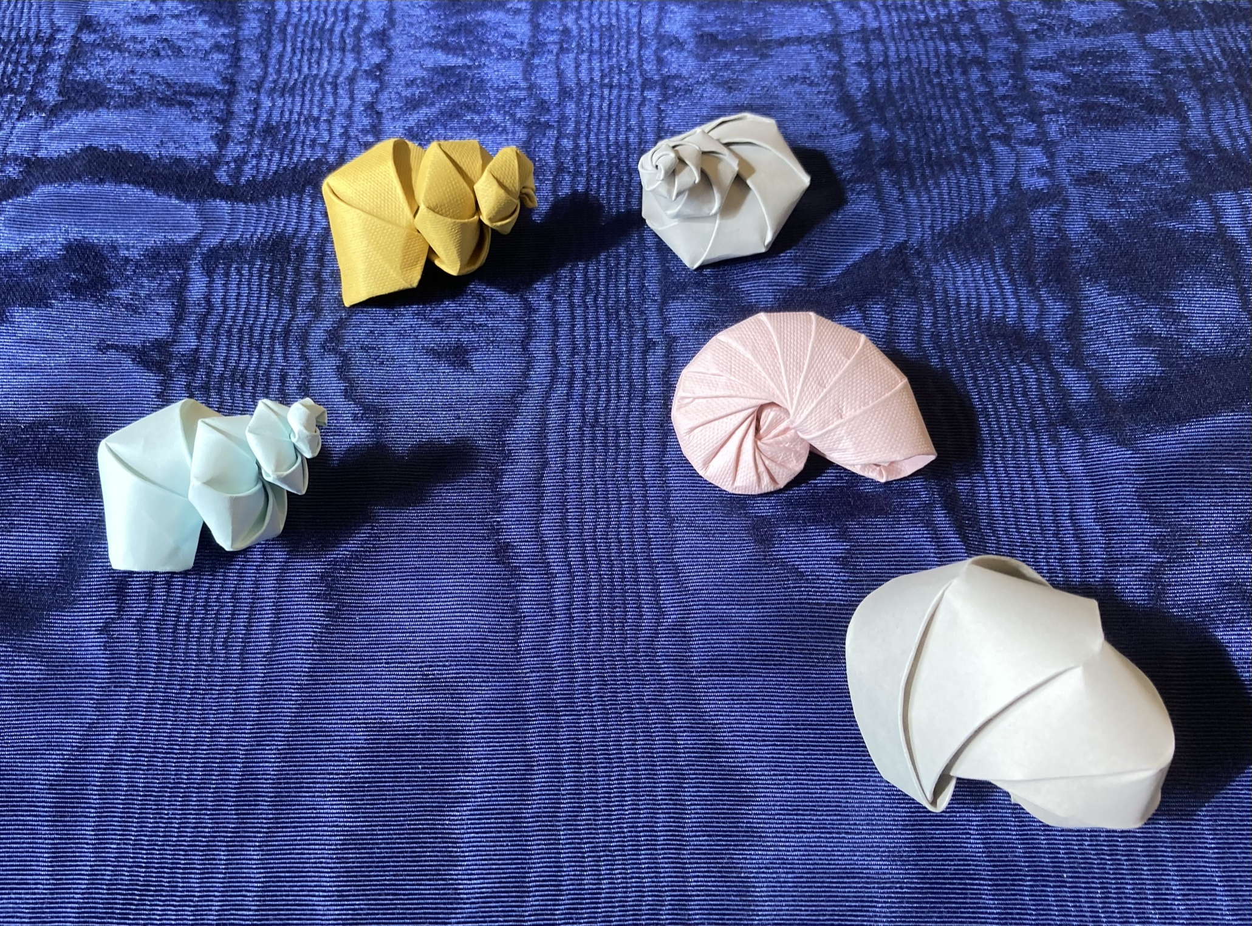
More Paper Snails
Turbinate
caL = 0, caR = 15 saL= 35, saR = 25
Planispiral
caL = caR = 25 saL= saR = 17
Notes:
(Live show snails)
Anyway, copy paper is hard, cardstock is easier
I can do planispiral as well, nice nautilus that curls in on itself.

Slide 21
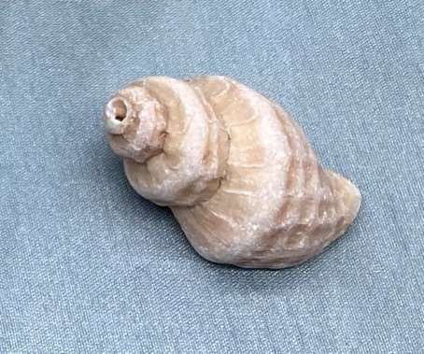
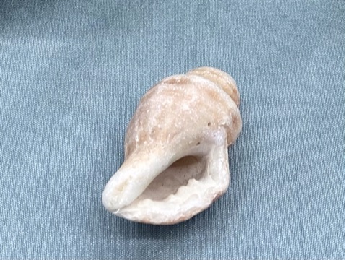
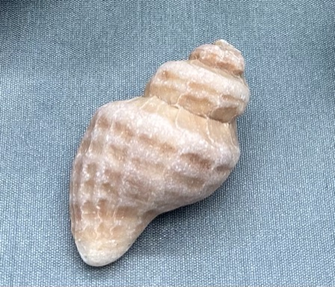
Next: Conches
Notes:
(live show conch?)
I have plans for continuing, I’m hoping to make conches.
It has proven to be much harder…
The generating function is no longer a circle…

Slide 22
About Me: Elecia (Engelman) White ‘96
I’m an embedded software engineer; I write software for things that aren’t computers. The applications are endless.
I’m a consultant and my company is Logical Elegance, Inc.
I wrote O’Reilly’s Making Embedded Systems, a great-eared nightjar.
CW ’96 and I host the Embedded podcast where we talk about engineering, science art, teaching, and sometimes embedded systems.
Mudd Individual Program of Study: applied CS and theoretical engineering (programming and Fourier). Two concentrations: art and theories of learning.
I really like snails. And origami. And robots.
Notes:
A quick slide about me
I think the important bit here is that
Chris White and I host a podcast
called Embedded
where we talk about STEM/STEAM topics
It is in all the usual podcast apps.
And we really like Mudders as guests.
Our previous speaker,
Dan Shapiro was on our show years ago,
when Glowforge was getting off the ground and his book Hot Seat had just come out.
I’m easy to find if you want to chat.

Slide 23
Thank you!
Insert snail joke here.

Slide 24
Sources
Mollusk Morphology
Computer as Aid in Describing Form in Gastropod Shells. Raup, David M, 1962.
Geometric Analysis of Shell Coiling. Raup, David M, 1966.
A Natural History of Shells. Vermeij, Geerat J, 1993.
Snail Facts
Spirals in Time: The Secret Life and Curious Afterlife of Seashells. Scales, Helen, 2015.
Origami Books:
Tomoko Fuse: Spirals
Jun Mitani: Curved Folding Origami Design
https://github.com/eleciawhite/origami (colab)

Slide 25
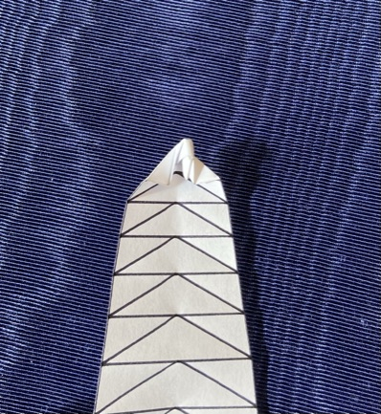
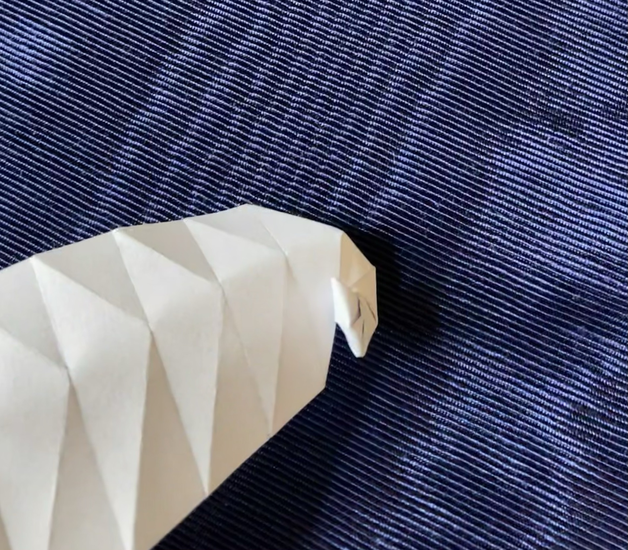
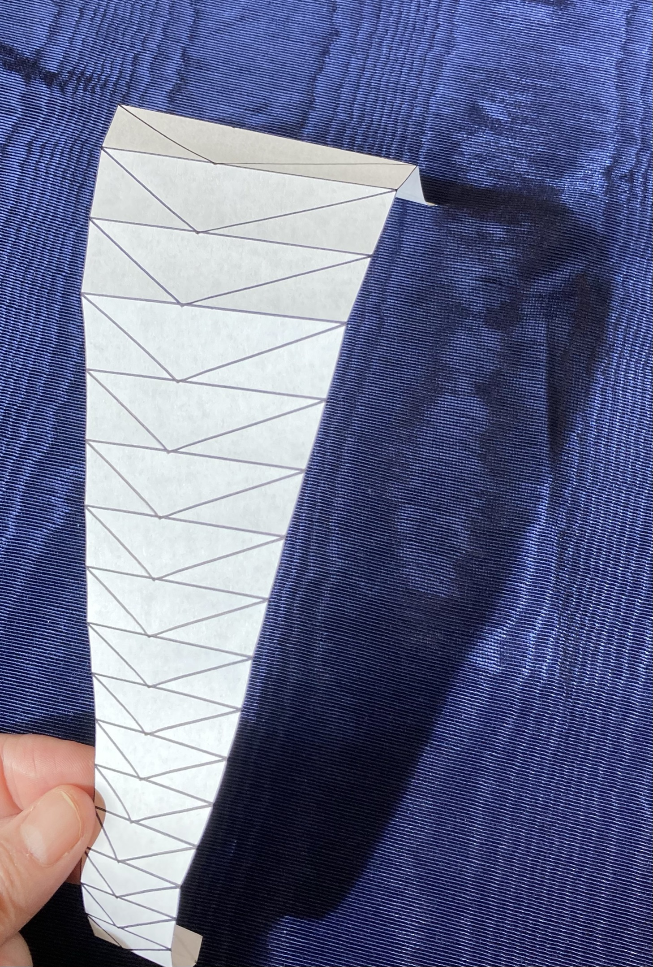
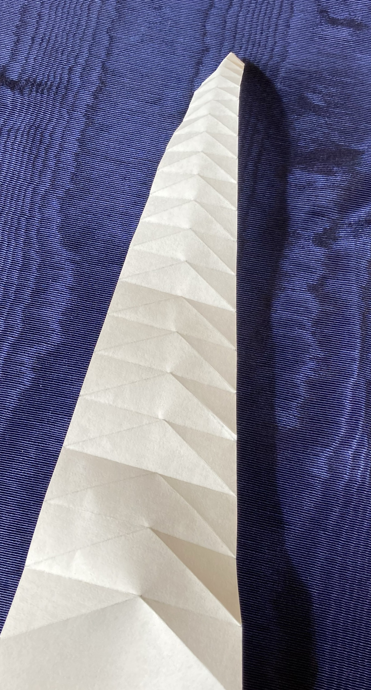
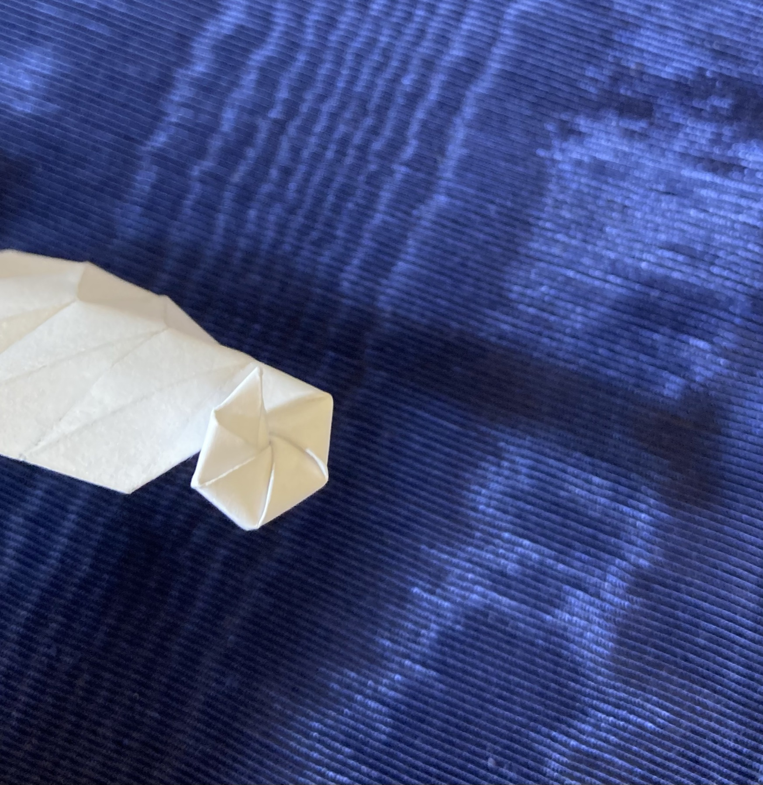
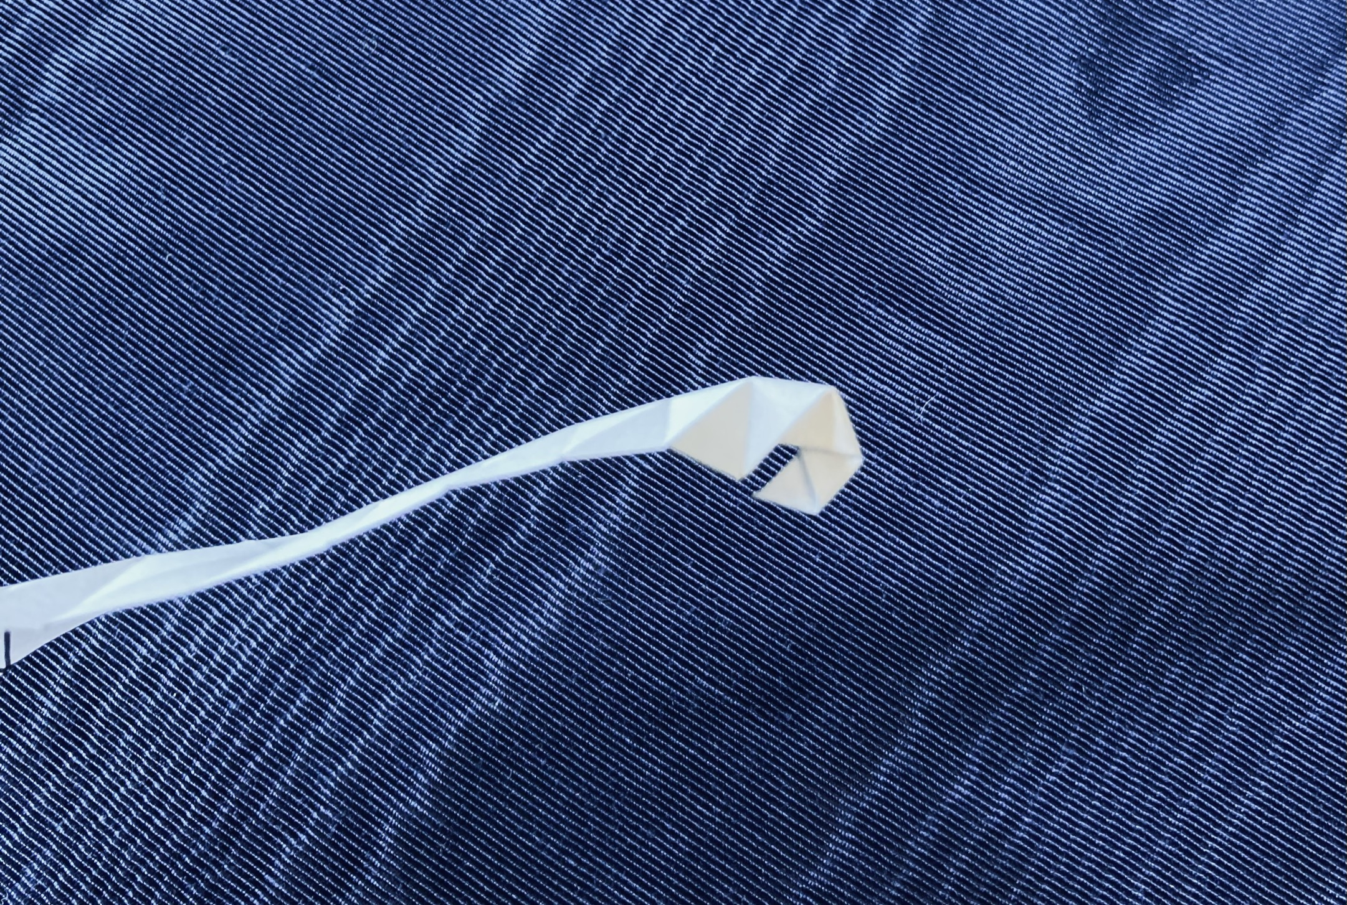
Folding Triangles: 4 steps
Notes:
To fold these, you
Print out the pattern, cut the shape.
Fold all the horizontals one way, we’ll call this mountain
Fold all the diagonals the other way, we’ll call this valley
Then do an inside reverse fold at the tip.
No, seriously, you just follow the creases and make a little tip
Then you keep folding back and forth
And then you get to the point where the tip is going to get hidden, you push it out
Which makes folding things on that side a bit tricker as you have to tuck things into the body whorl
And then, viola, you have a snail.

Slide 26
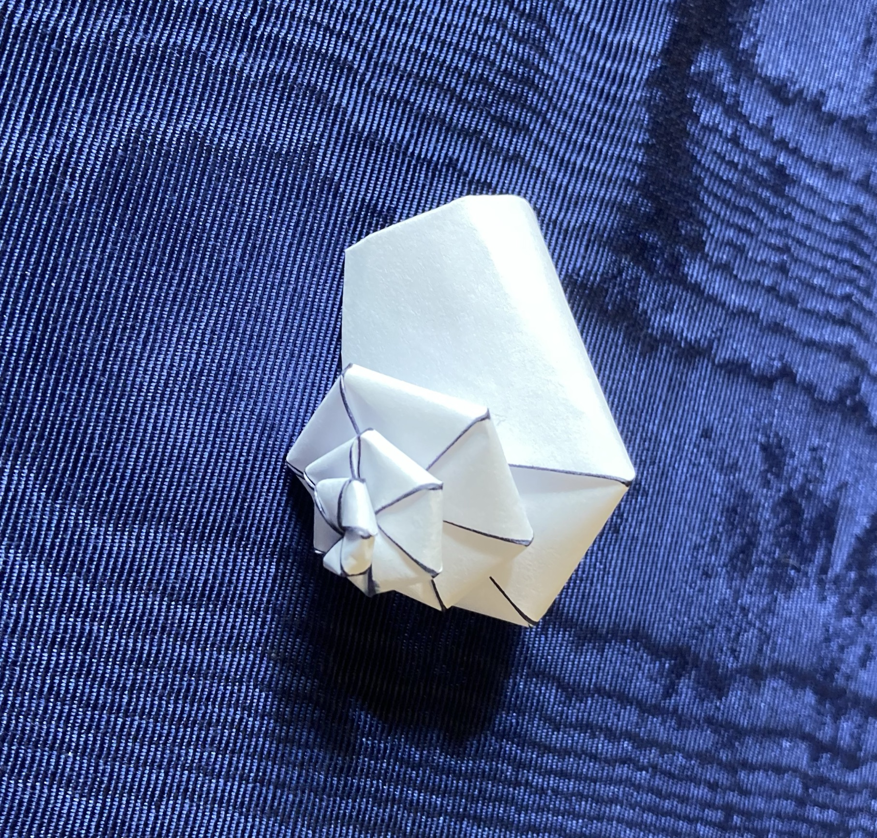
Notes:
Voila

Slide 27
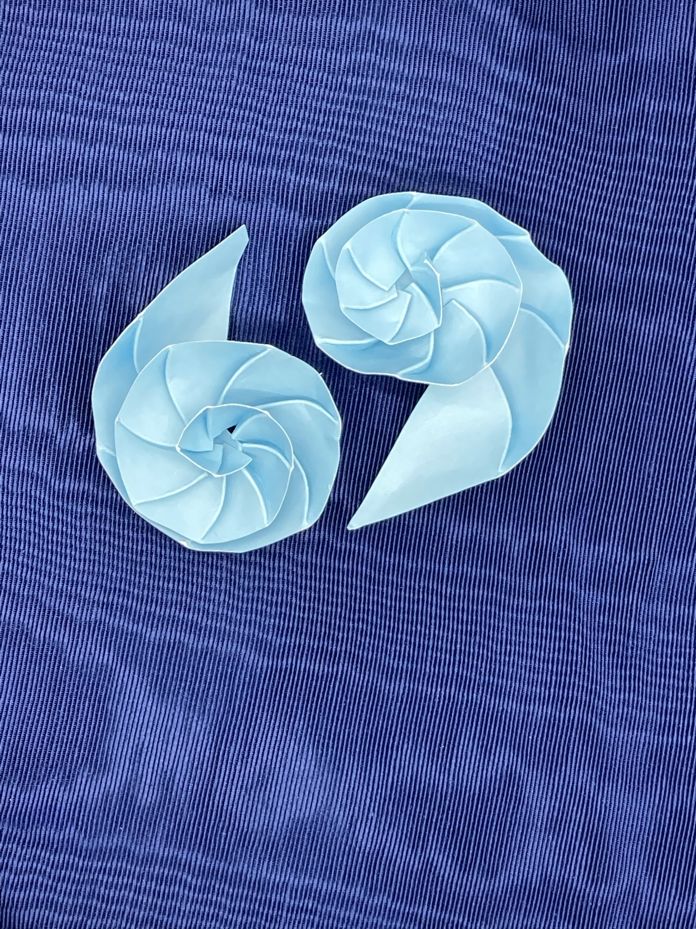
Nautilus Half-shell
Notes:
Easy to fold, cut a planispiral pattern in half.
Easier to do that than to cut an actual snail in half.

Slide 28
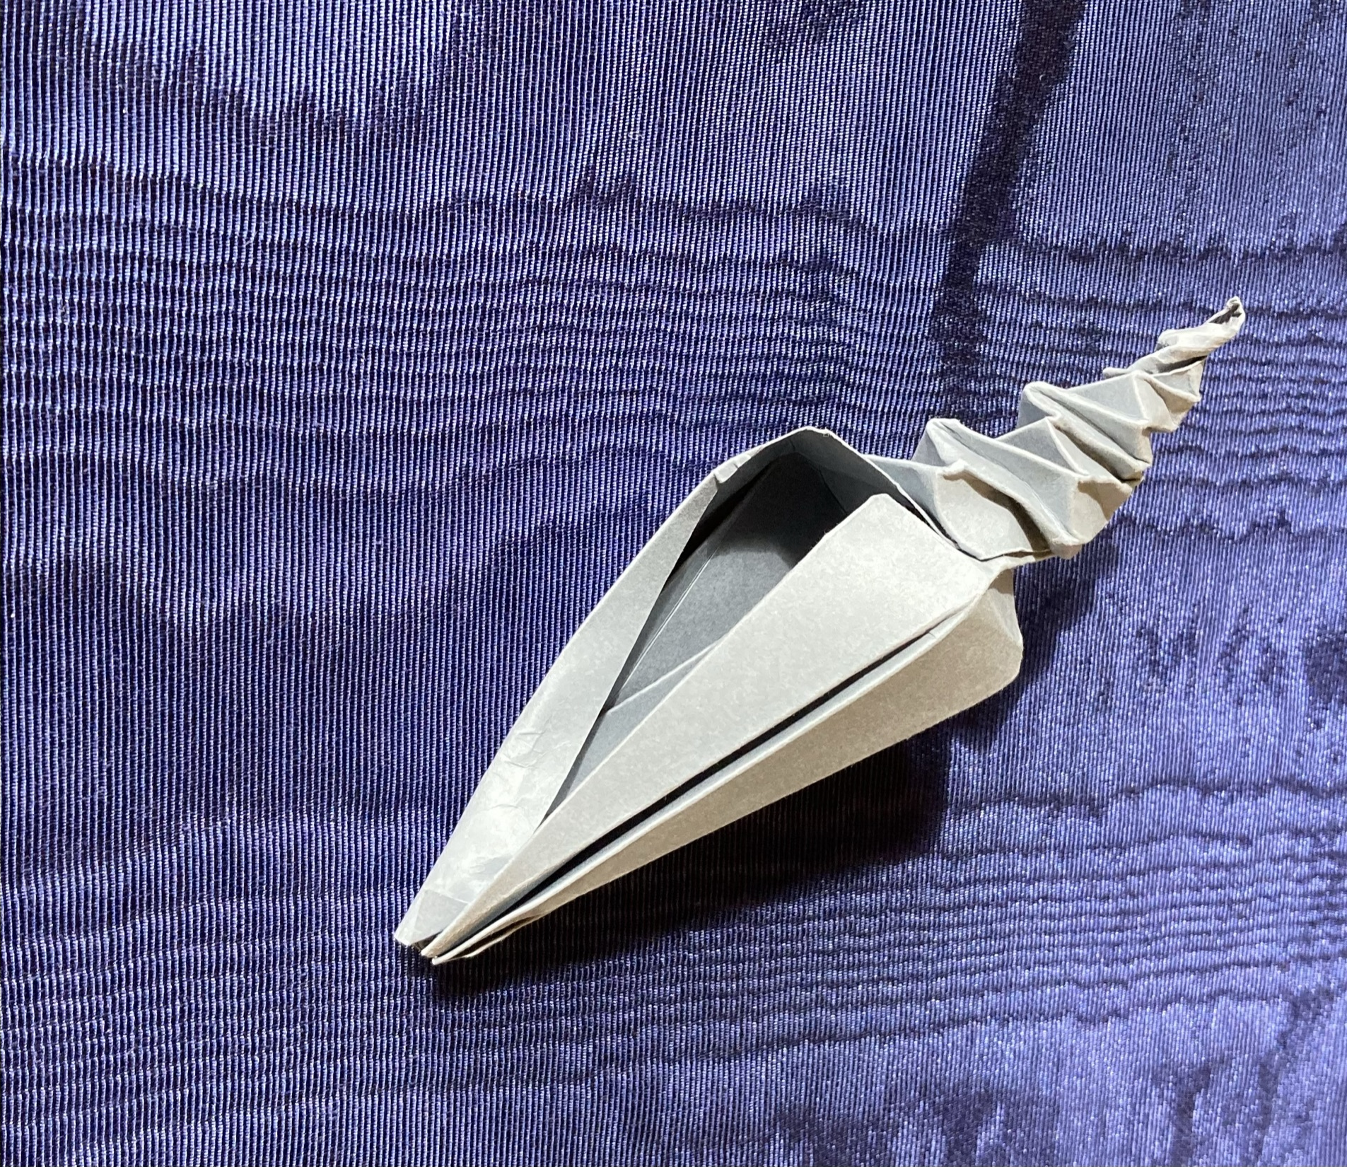
Conch? Needs work.
Notes:
Not quite there yet but I’m not out of ideas either
This is in curlpool.py in the git repo.
It uses a different method to generate patterns,
based on Fuse’s whirlpool patterns and screw shell pattern.
It also uses matpolotlib’s patches to much greater effect.

Slide 29
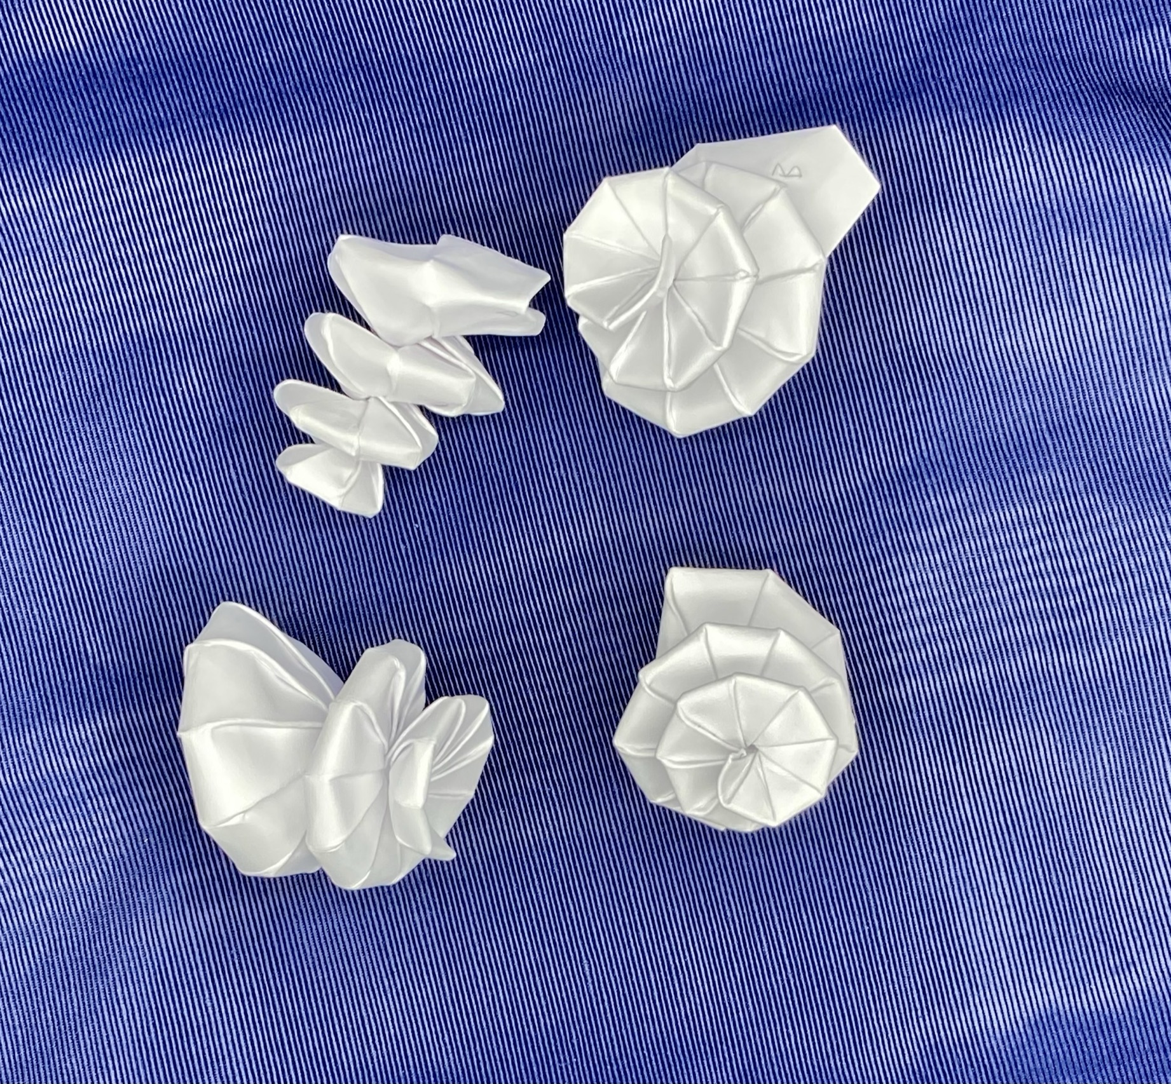
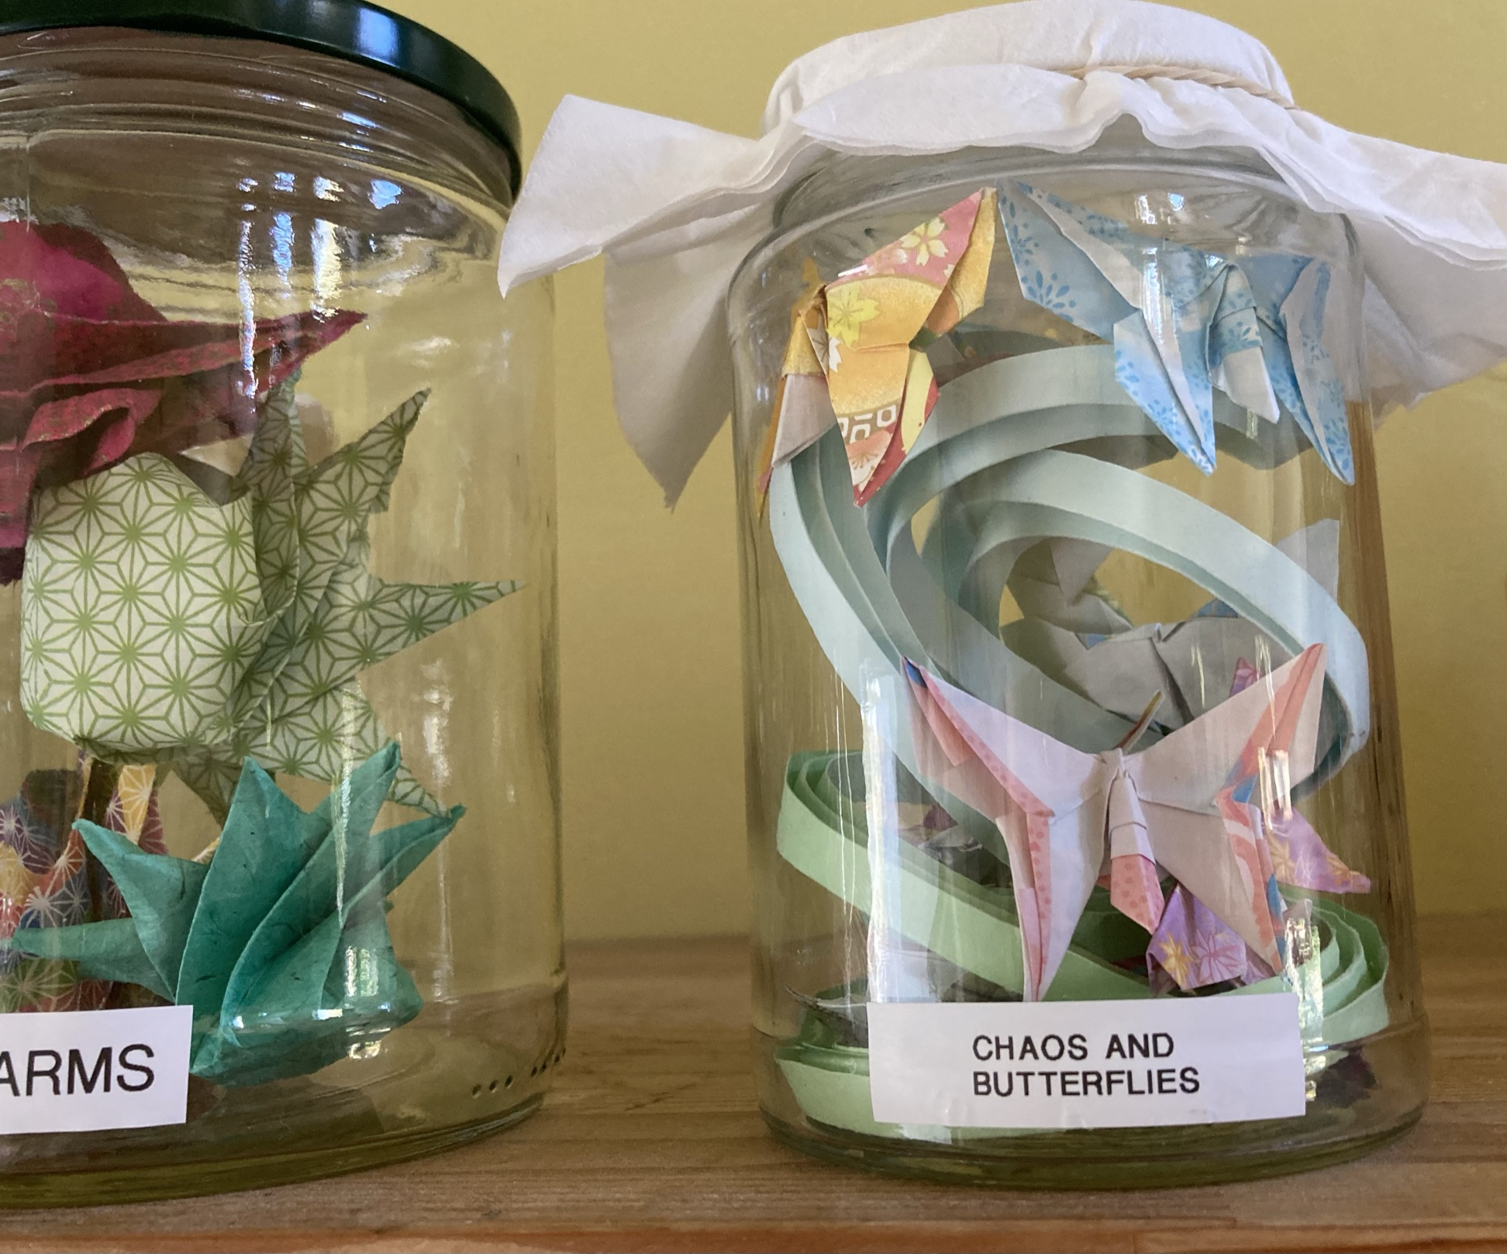
?
Notes:
Really neat failures. Pushing the Bezier curves as far as the paper will let them go

Slide 30
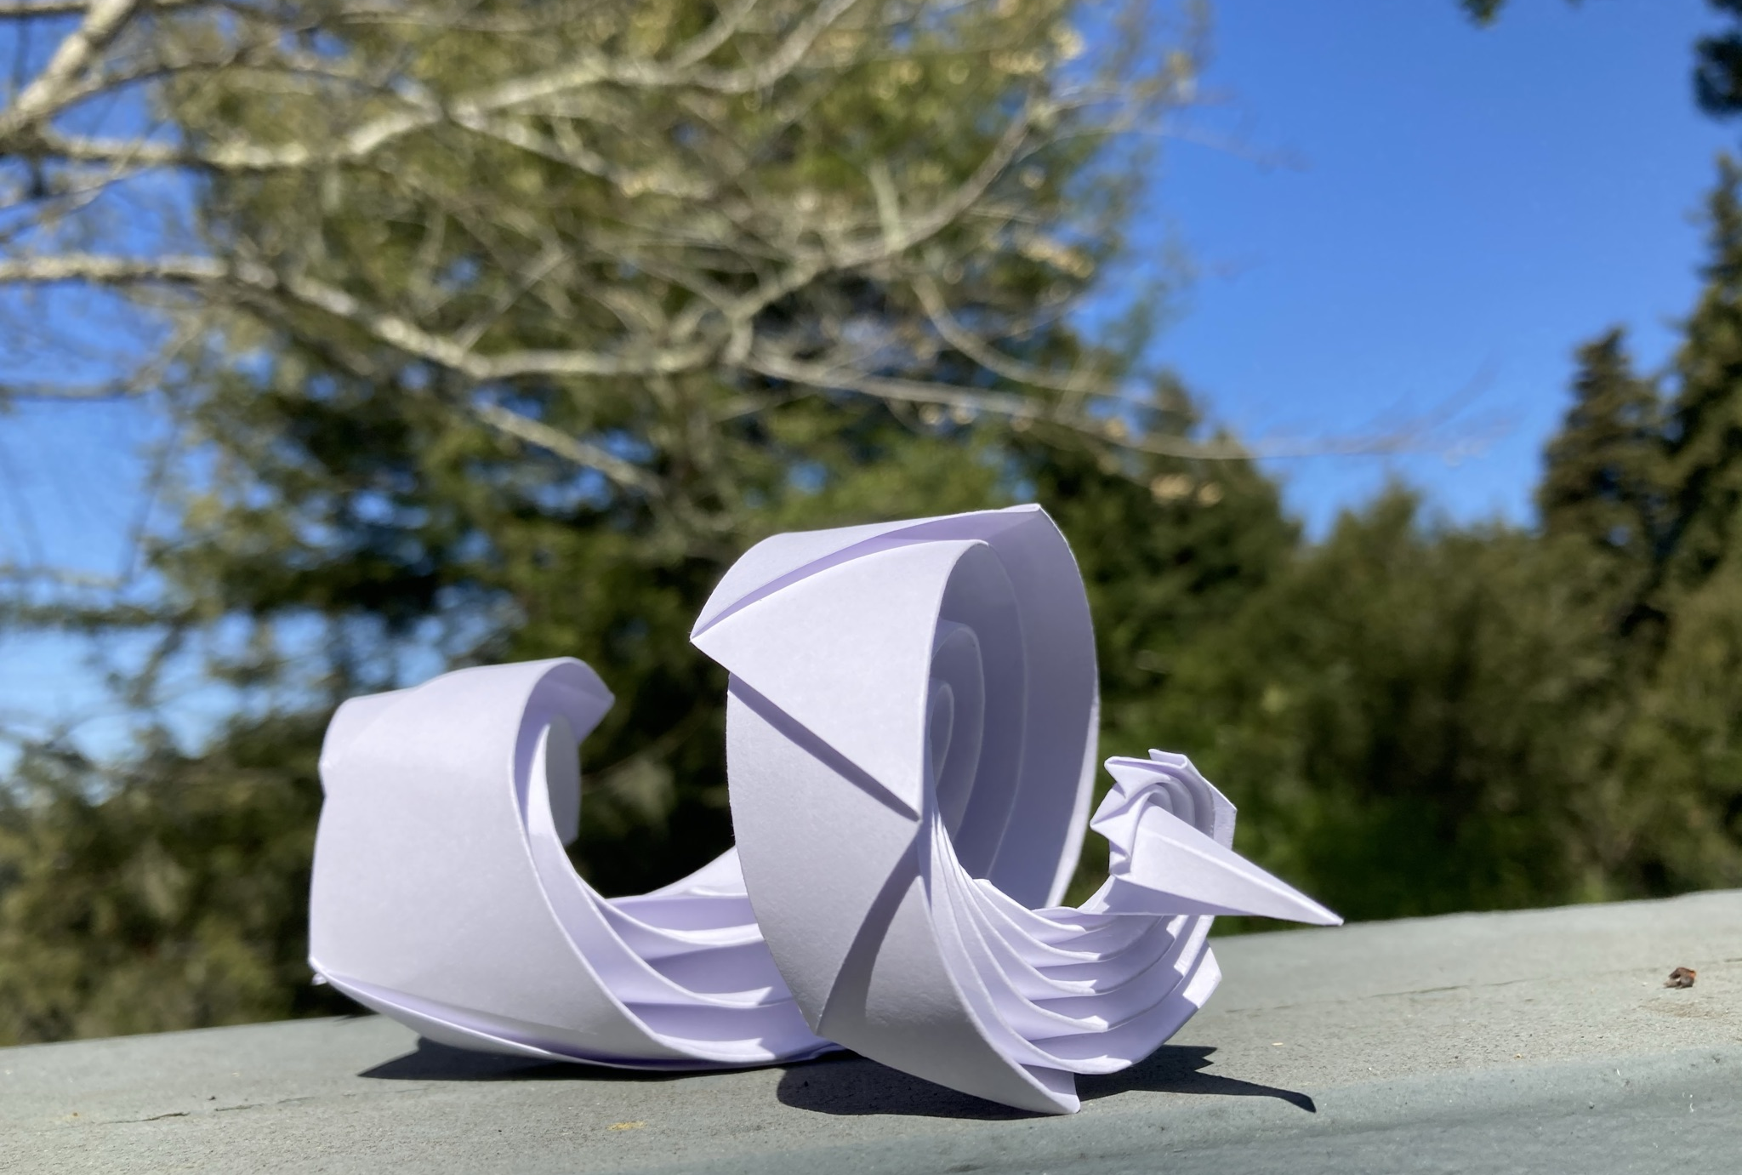
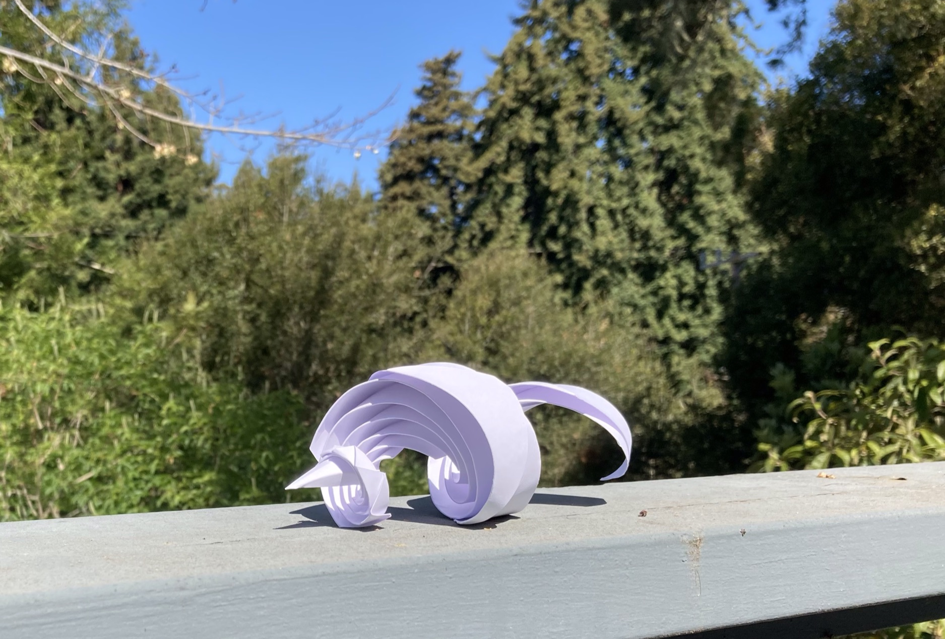
Luck Dragon
Curved crease and pleated
Notes:
Totally an accident

Slide 31
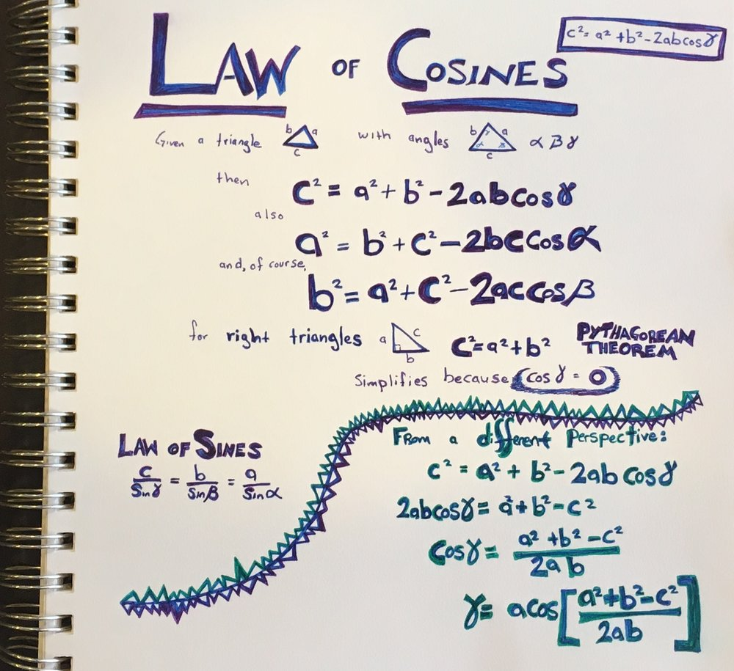
Programming Triangles
Step 1: Hope
Step 2: Fear
Step 3: Bargaining
….
Step 99: Geometry, specifically trigonometry
Notes:
Short detour for a complaint about our math education.
Why do we focus so much on the Pythagorean theorem and right triangles?
The Law of Cosines works on any triangle and it is so much better.
Though really all I needed was the law of sines.
I didn’t make this sheet for this talk or for origami snails,
it is left over from working on robot kinematics…
just in case you ever wondered about
the degree of separation between robot arms and paper snails.

